Slide 1
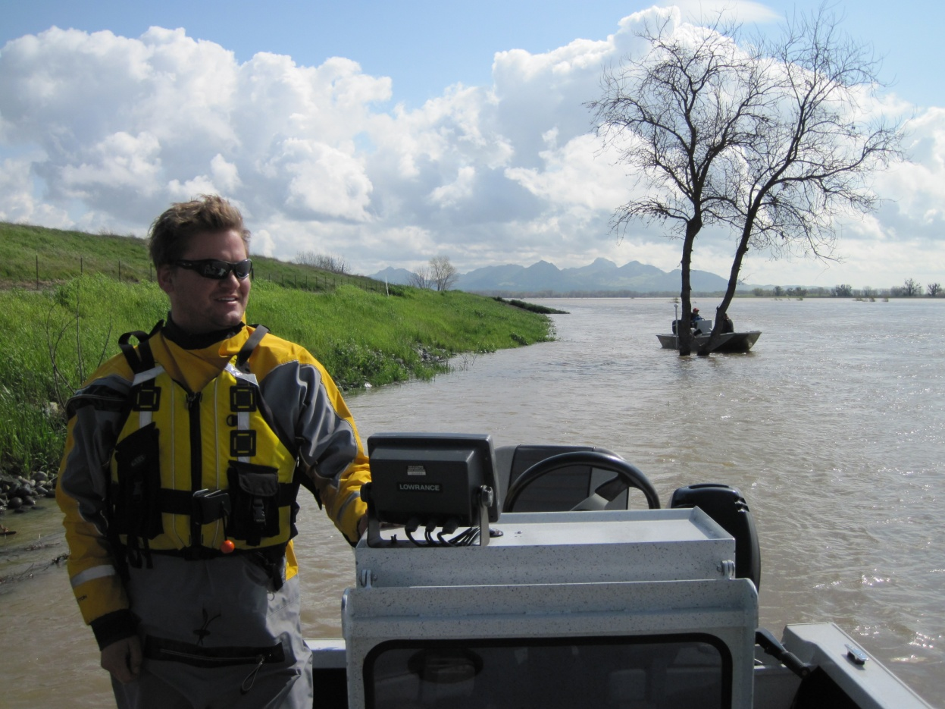

Slide 2
California Climate, Extreme Events and Climate Change Implications
Peter Coombe
Staff Environmental Scientist
CA Department of Water Resources
pcoombe@water.ca.gov

Slide 3
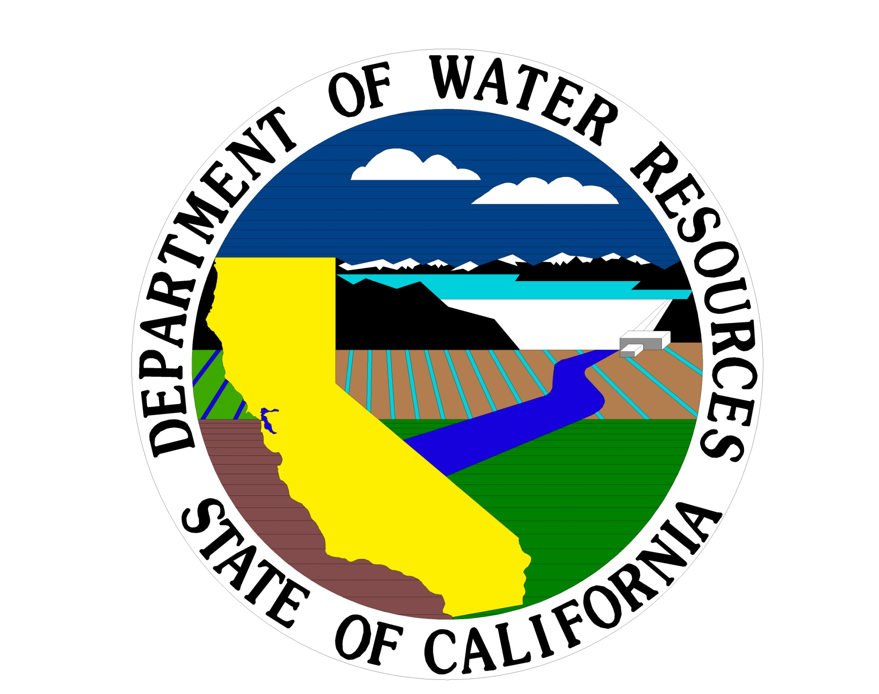
DWR Forecasting
DWR forecasts future water needs, evaluates and inventories existing water supplies, explores conservation, and storage options.

Slide 4
Climate: Long term average conditions
Weather:
The conditions day to day

Slide 5
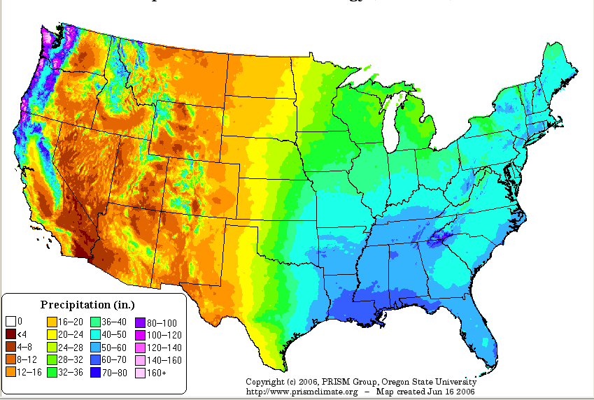
PRISM Annual Precipitation (1961-1990) Map
(Parameter-elevation Regressions on Independent Slopes Model)

Slide 6
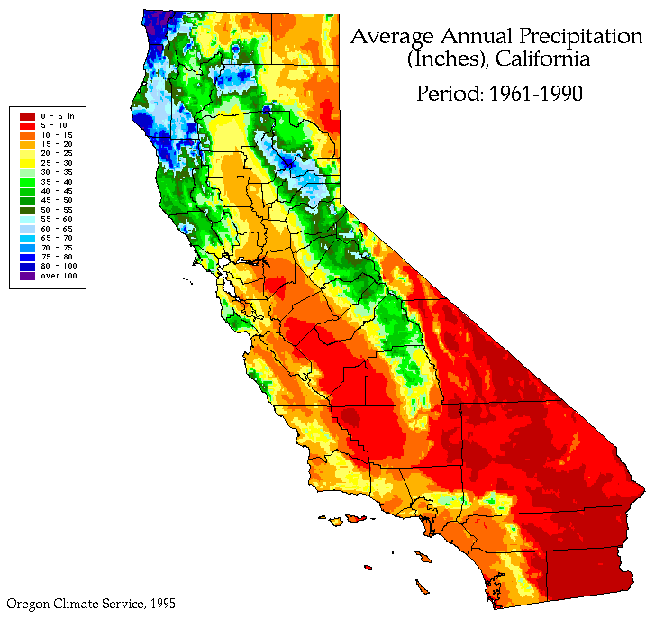
California Precipitation
 | CA
Mean Annual Precipitation In./Yr. | 22.8
Maximum Daily Precipitation In. | 26.1
Precipitation Patterns | Winter- Spring
Notes:
The largest one-day rain occurred at Hoegees Camp in 1943 in the mountains east of Los Angeles when 26.12
inches of precipitation was recorded .
The average annual rainfall for the State is estimated to be 23 inches per year. The range in average annual rainfall is from a high of 144.3 at Ship Mountain in the Smith River basin in the northwest to a low of 1.8 inches per year at Death Valley. Another remarkable thing about rainfall variability in California is that the variability of the most recent 50 years is far greater than the previous 50 years, as will be shown.

Slide 7
Year to Year Precipitation Variability
California precipitation is uniquely variable
Std Dev of Annual Precipitation
Mean Annual Precipitation
Std Dev of Annual Precipitation
Mean Annual Precipitation
Dettinger et al, 2011

Slide 8
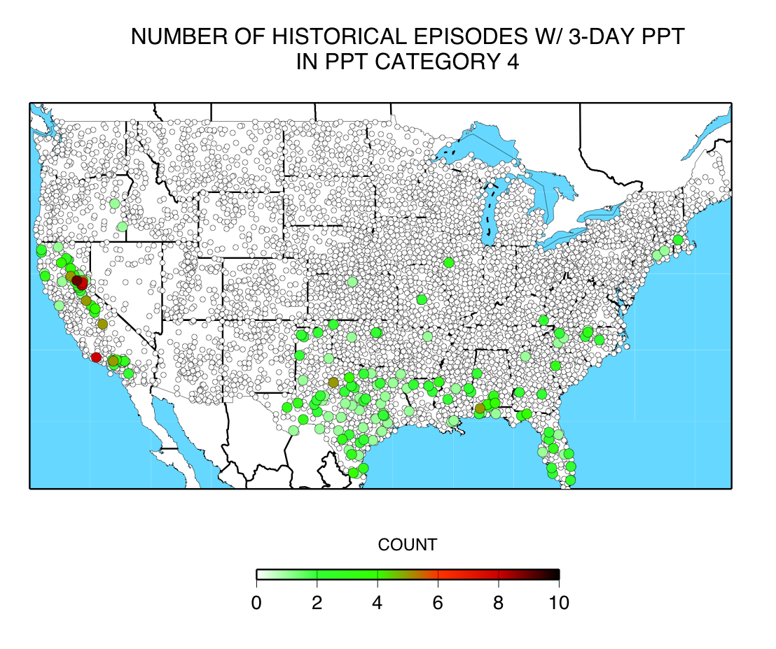
Three-day episodes with > 16 Inches precipitation since 1950
Dettinger et al, 2011

Slide 9
Storms and California Water Supply
Just a few storms each year are the core of California’s water supplies
Dettinger et al, 2011

Slide 10
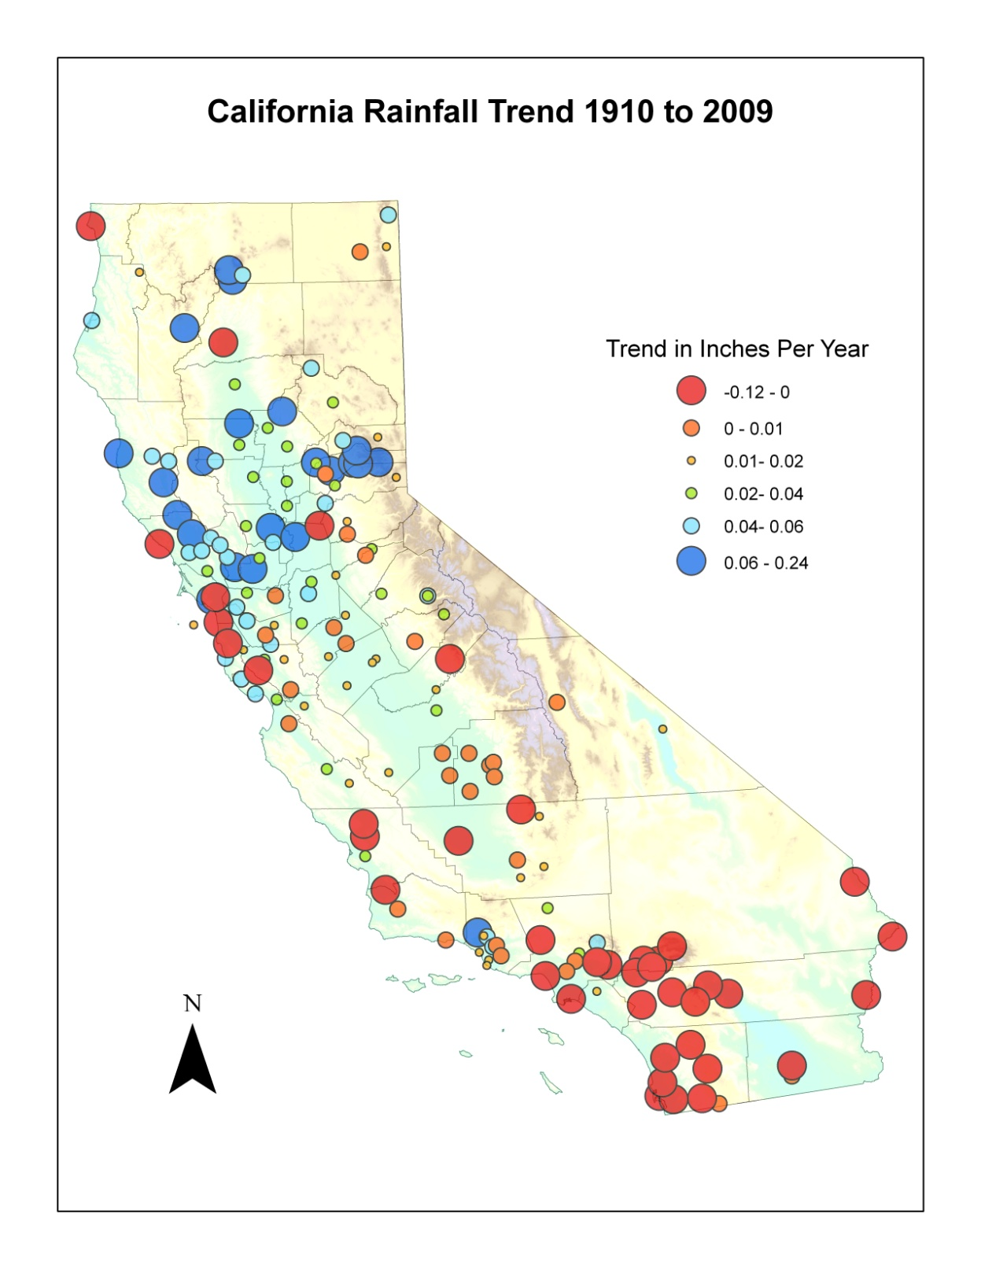
Driest 30 years:
1908-1937 21.28 inches
Wettest 30 years:
1977-2006 24.88 inches

Slide 11
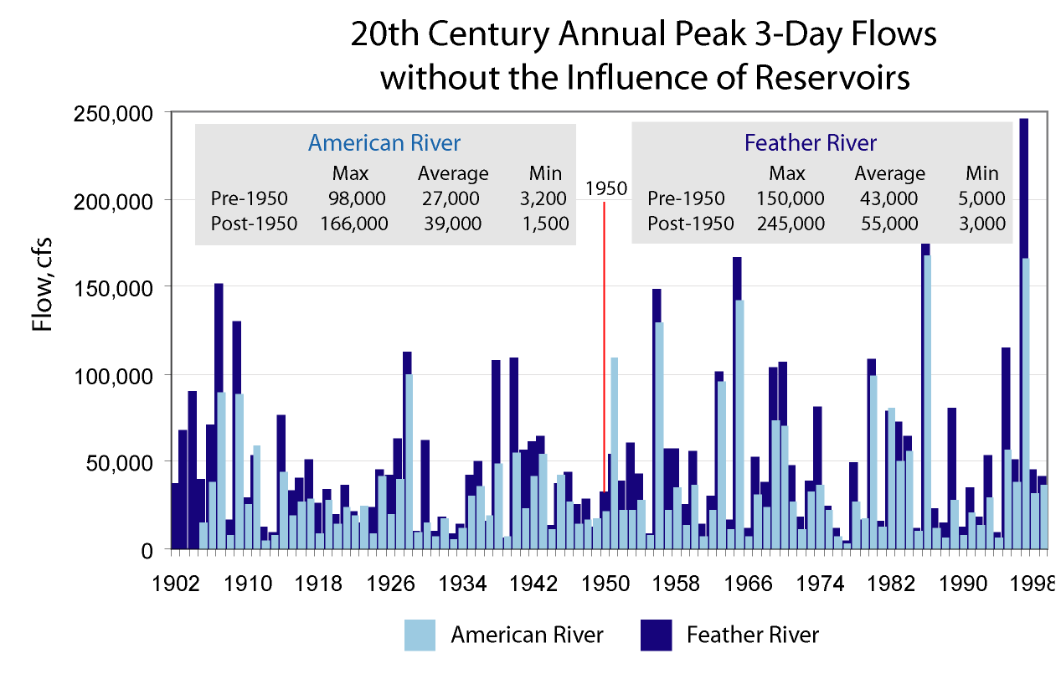
Notes:
1955-
On the first day that the Folsom Dam was declared operational it went to uncontrolled spill.

Slide 12
Year | Storms
1865 | 2
1875 | 2
1885 | 4
1895 | 3
1905 | 1
1915 | 7
1925 | 4
1935 | 4
1945 | 3
1955 | 5
1965 | 9
1975 | 6
1985 | 10
1995 | 21
2005 | 10

Slide 13
Extreme Precipitation and Storm Frequency
The Top 5 “Worst” Storms of the 20th Century
in California
“Nature in California,” . . . The San Francisco journalist Carl Nolte observed . . . “is a smiling killer that can turn on you at any time.”
Notes:
Thousand year rainfalls have occurred several times in California in the memory of residents. There have been so few in the short period of the state's recorded history that casual observers question their reality. The key to understanding their frequency is to realize that very intense storms cover very limited areas and California is a very large region.

Slide 14
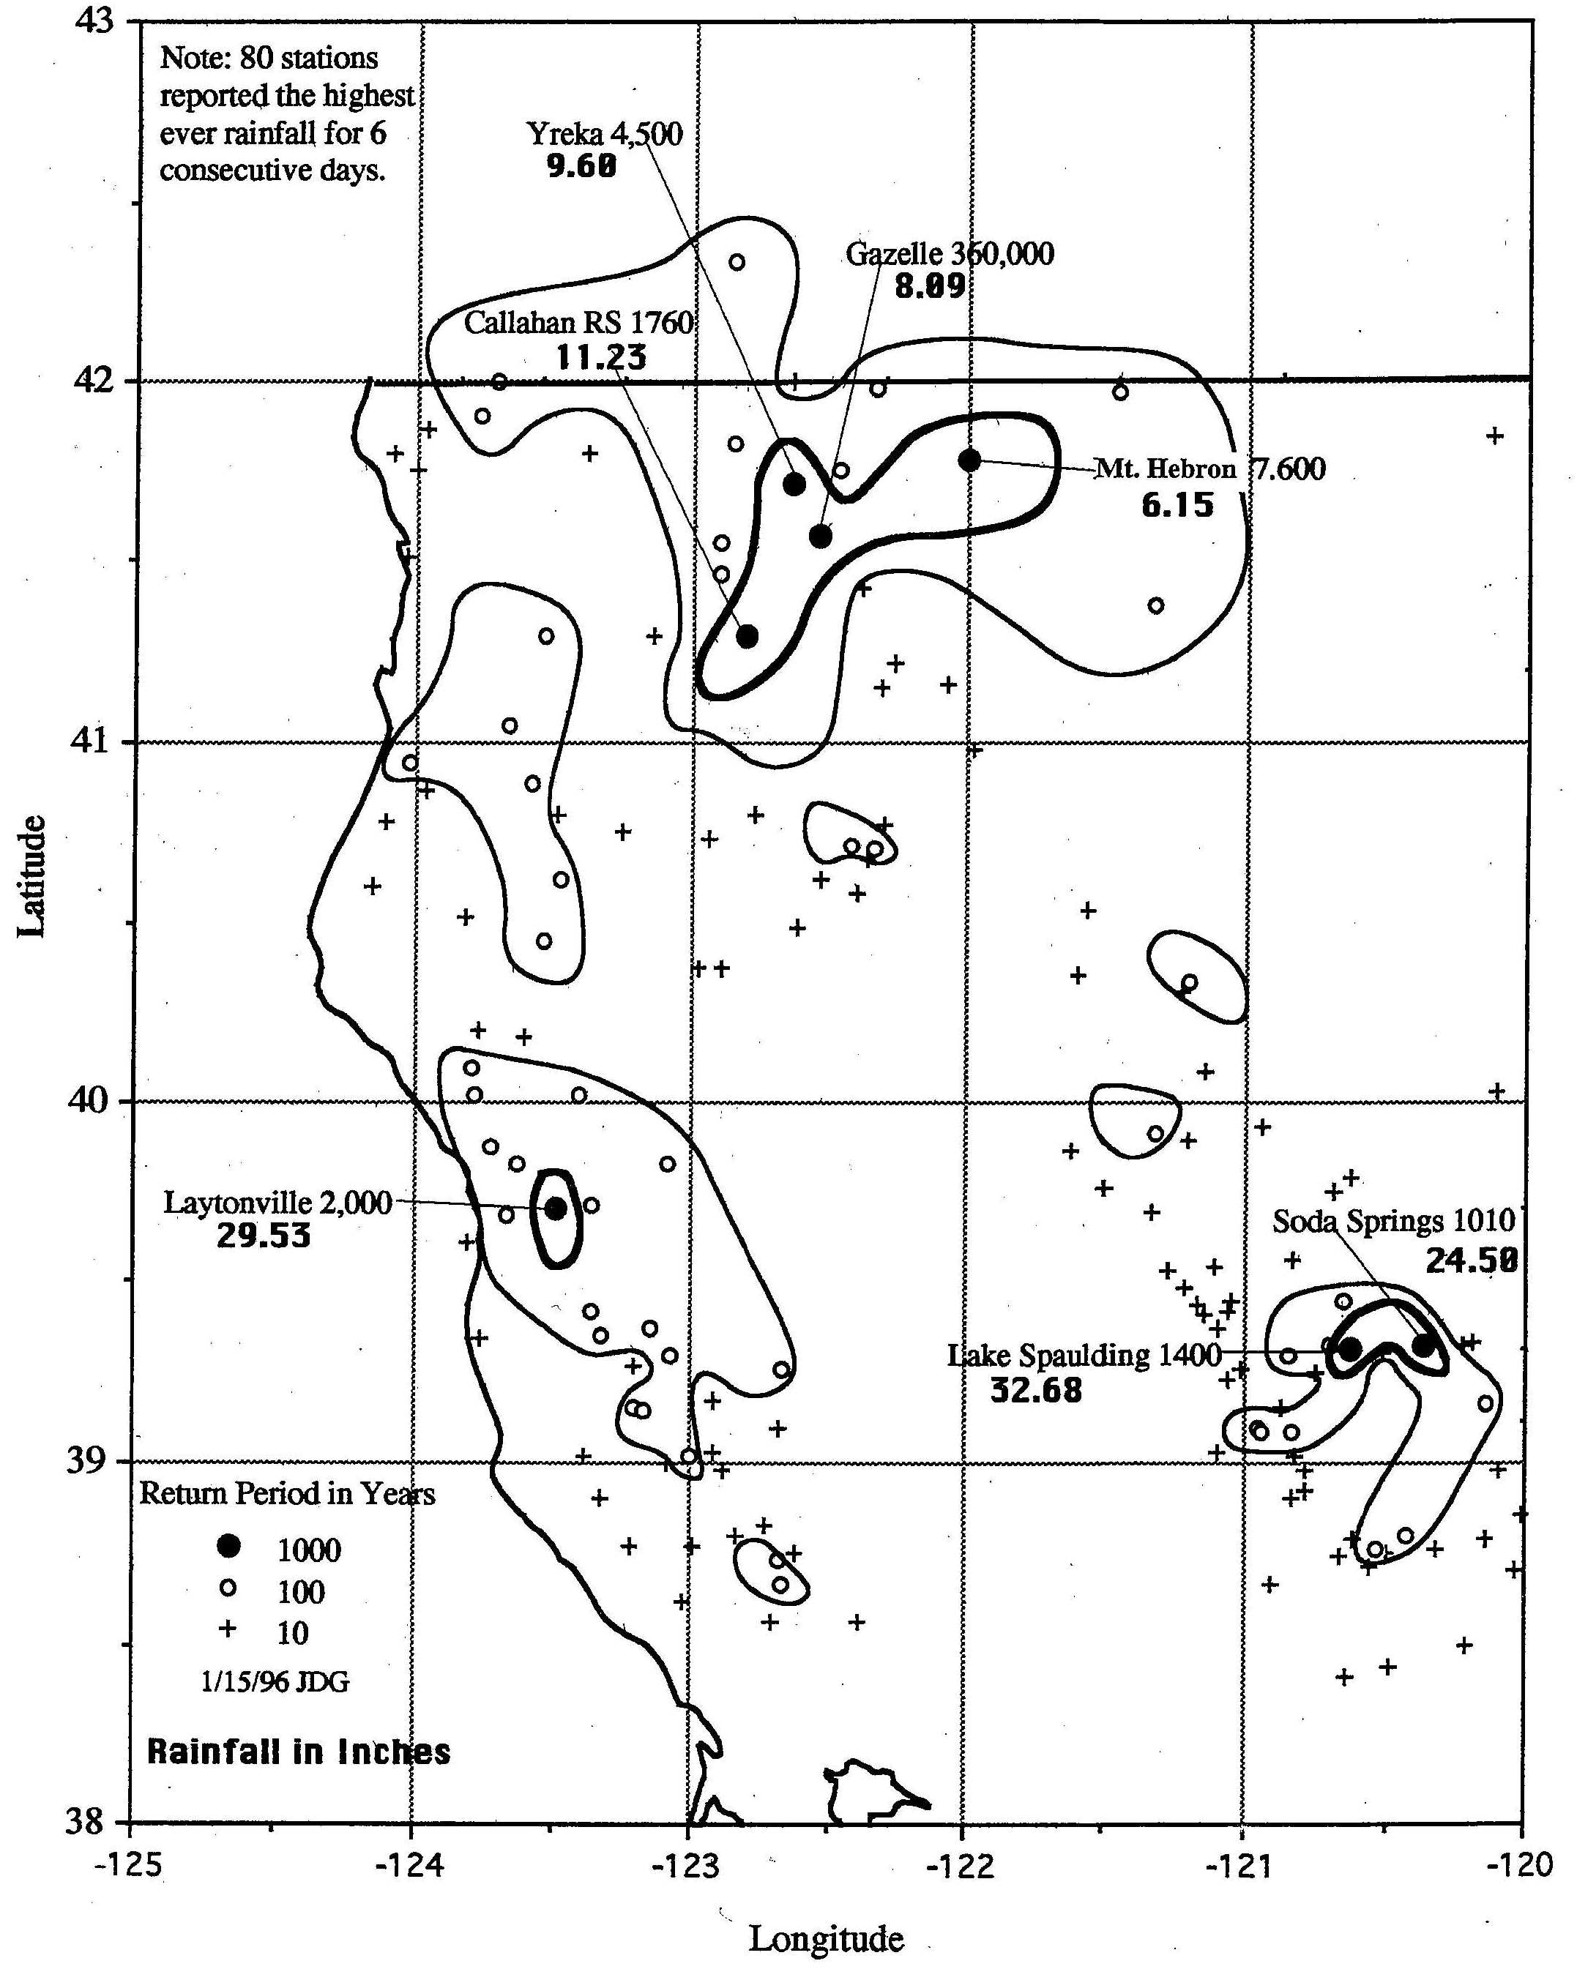
#5
1964 December 19 to 24
Notes:
Number five on the list of the California’s worst storms was centered in the North Coast on the Eel and Klamath River Basins. The six days from December 19 through 24, 1964 were the wettest ever recorded at 101 Northern California Stations. The North Coast had the worst flooding ever experienced in that region. Every major stream in this North Coast produced new high values of extreme peak flows. Thirty-four counties in California were declared disaster areas.
There were three major centers of activity. These are the Eel River, the Upper Klamath and the Yuba River in the Central Sierra Nevada.
The highest 6-day rainfall reported for the Eel Basin was 31.71 inches at Branscomb.

Slide 15
#5
1964 December 19 to 24

Slide 16
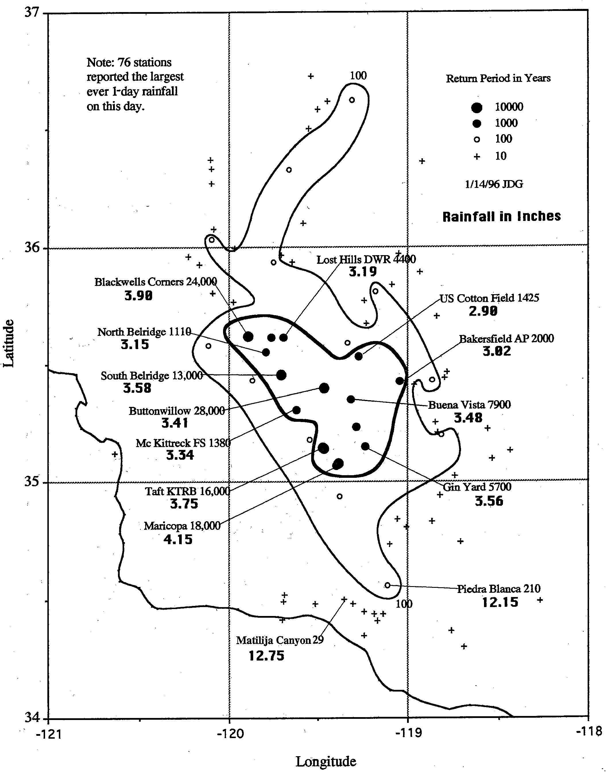
#4
1978 February 10
Notes:
Number four on the list of the California’s worst storms was centered Southern San Jaoquin Valley. A vigorous winter cyclonic storm with wide spread flooding and mud-slides developed on the windward slopes of the South Coastal Basin on February 10, 1978. There were 18 deaths reported with this storm and $120 million in storm related damage. This storm was still quite robust as it moved northeasterly into the comparatively dry San Joaquin Valley. This is another case of an energetic storm moving into a "rain shadow" area before it dissipates.
The heaviest rainfall depth of this storm was at Matilija Canyon in Ventura County to the south west of Buena Vista Lake Basin where 13.31 inches in one day was reported.

Slide 17
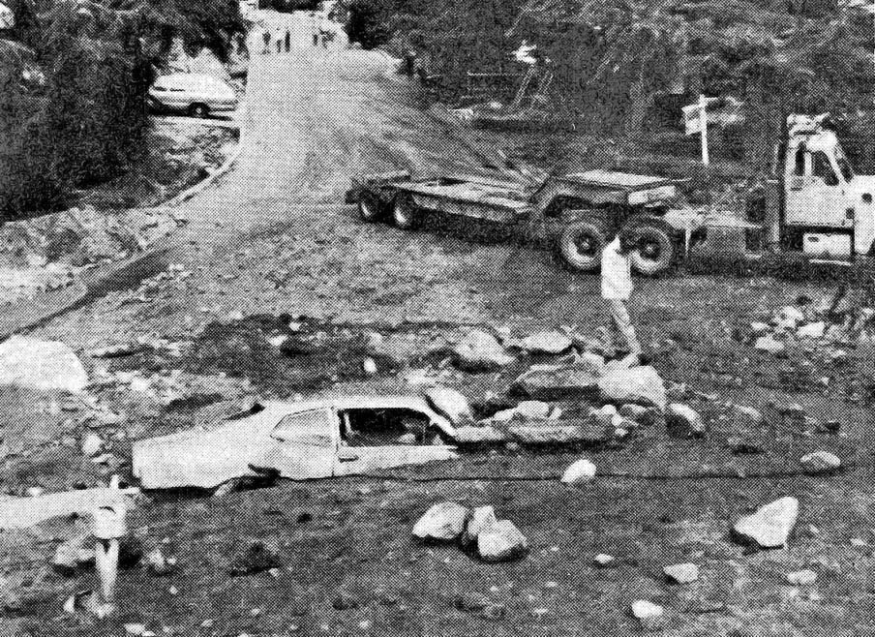
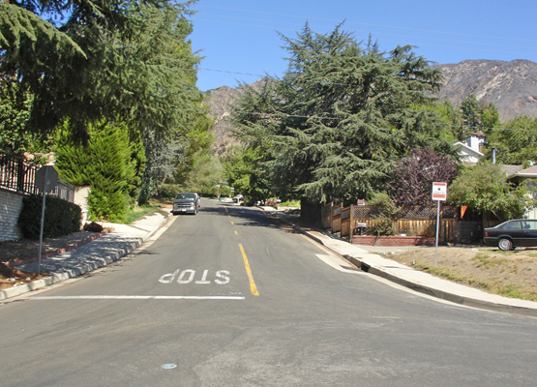
Then
#4
1978 February 10
Now
Notes:
Number four on the list of the California’s worst storms was centered Southern San Jaoquin Valley. A vigorous winter cyclonic storm with wide spread flooding and mud-slides developed on the windward slopes of the South Coastal Basin on February 10, 1978. There were 18 deaths reported with this storm and $120 million in storm related damage. This storm was still quite robust as it moved northeasterly into the comparatively dry San Joaquin Valley. This is another case of an energetic storm moving into a "rain shadow" area before it dissipates.
The heaviest rainfall depth of this storm was at Matilija Canyon in Ventura County to the south west of Buena Vista Lake Basin where 13.31 inches in one day was reported.

Slide 18
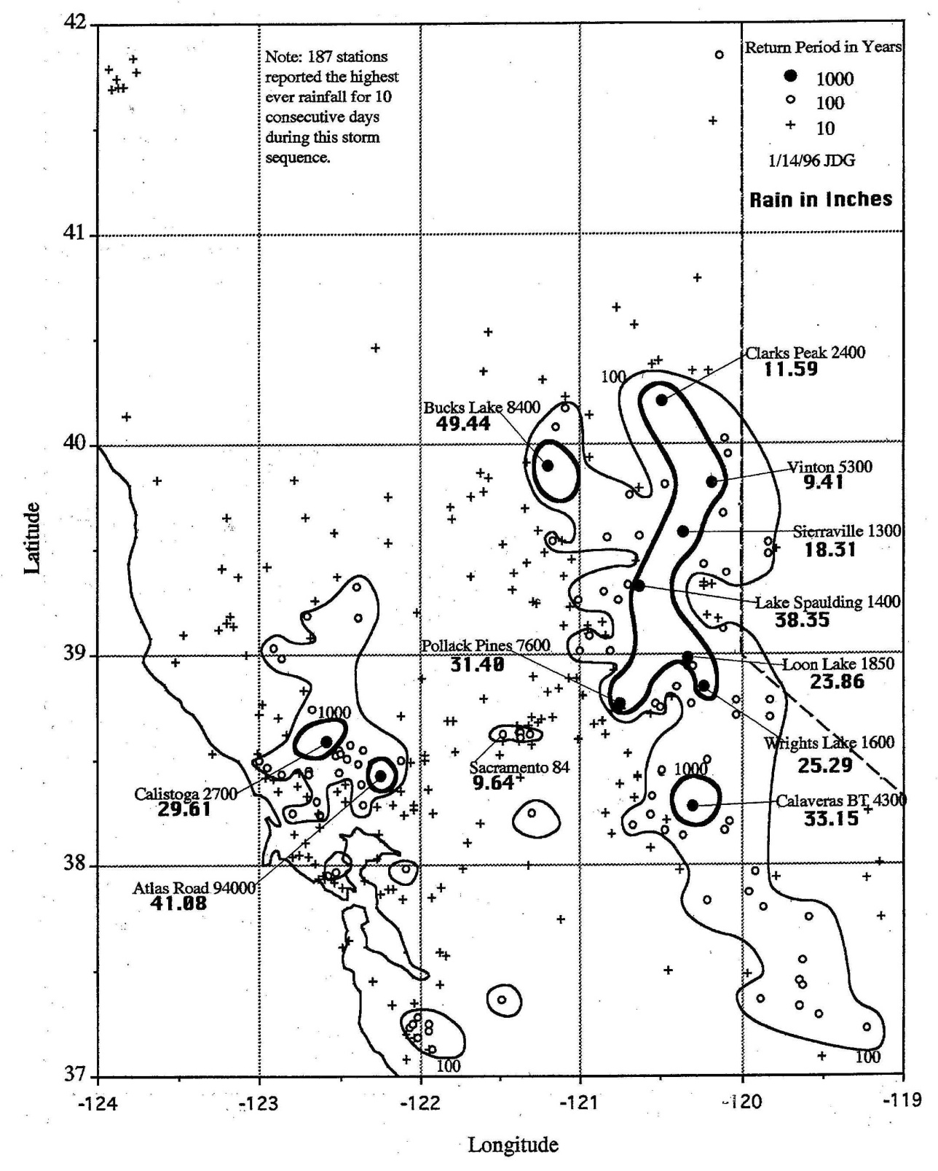
#3
1986 February 11 to 18
Notes:
Number three on the list of the California’s worst storms was centered in the Central Sierra and in the Napa River. A series of warm tropical storms resulted on a good soaking generally of the higher elevations. 237 stations reported the highest ever rainfalls for 10 consecutive days. Half of the average annual rain fell in the 10 days between the 11 and 20 of February at 182 stations. Four stations reported over 100% of their annual average rainfall occurred in 10 days
Widespread drenching rains in central California led to extensive flooding and mudslides. Flooding resulted in 13 deaths, 50,000 evacuations and over $400 million in property damage. This was the storm associated with a big levee failure on the Yuba River at Linda, across the river and south from Marysville.

Slide 19
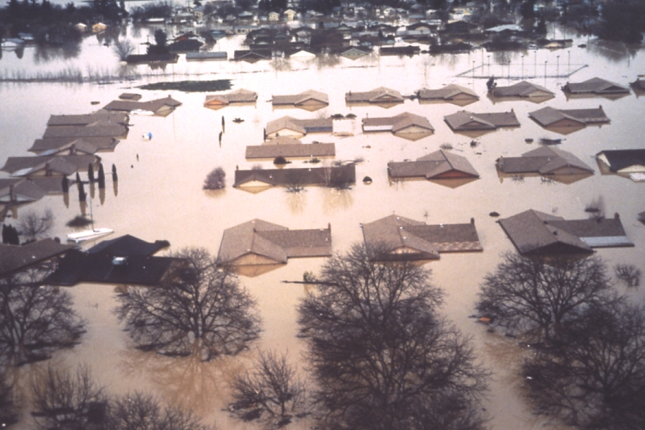
#3
1986 February 11 to 18
Notes:
Number three on the list of the California’s worst storms was centered in the Central Sierra and in the Napa River. A series of warm tropical storms resulted on a good soaking generally of the higher elevations. 237 stations reported the highest ever rainfalls for 10 consecutive days. Half of the average annual rain fell in the 10 days between the 11 and 20 of February at 182 stations. Four stations reported over 100% of their annual average rainfall occurred in 10 days
Widespread drenching rains in central California led to extensive flooding and mudslides. Flooding resulted in 13 deaths, 50,000 evacuations and over $400 million in property damage. This was the storm associated with a big levee failure on the Yuba River at Linda, across the river and south from Marysville.

Slide 20
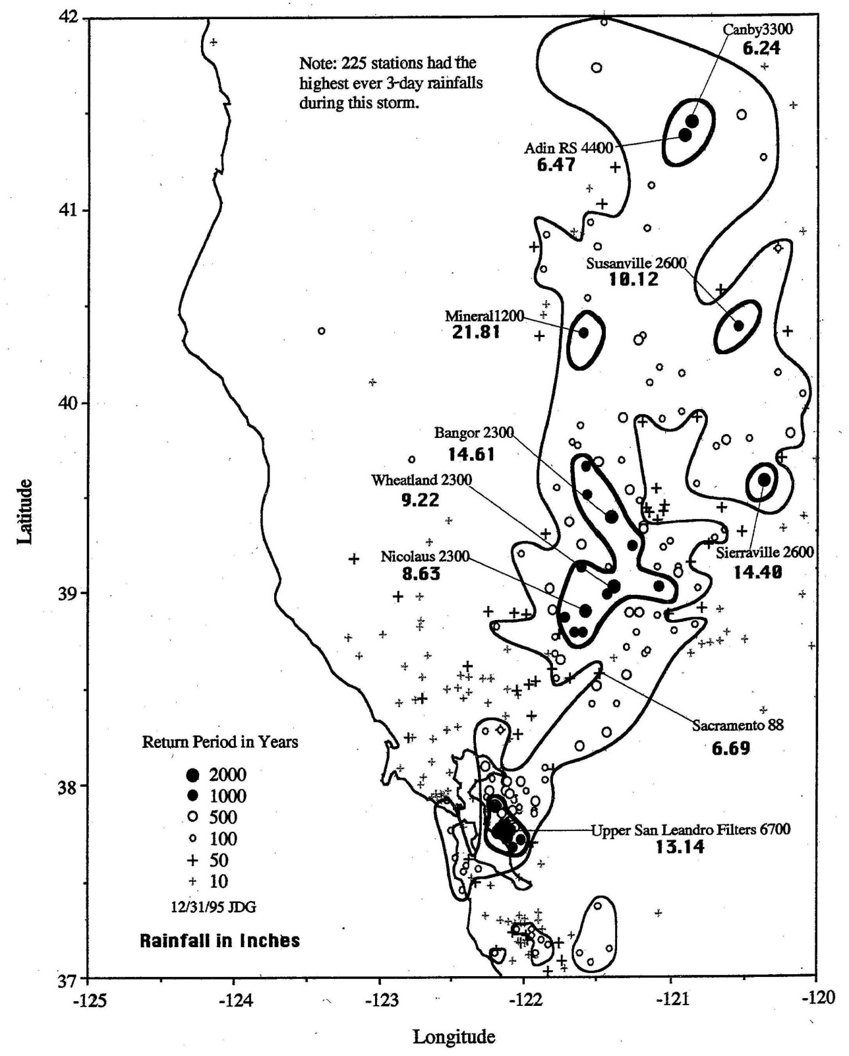
#2
1962 October 11 to 13
Notes:
Number two on the list of the California’s worst was the great Columbus Day Storm. The Storm of October 11 through 13, 1962 will be remembered for the high winds as well as for the record breaking rains. Millions of trees were blown down all along the Coastal areas from Washington State to Central California. There were 56 lives lost in this storm and $250 million in damage. Winds estimated gusting to 195 mph at Cape Blanco at 1 PM on the twelfth as their anemometer had already broken. Red Bluff reported their all time high wind of 82 miles per hour.

Slide 21
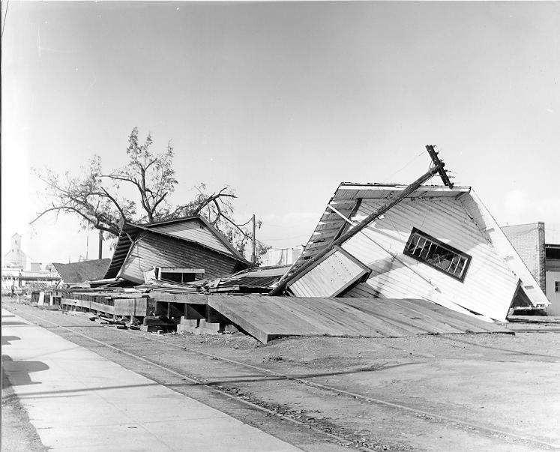
#2
1962 October 11 to 13
Notes:
Number two on the list of the California’s worst was the great Columbus Day Storm. The Storm of October 11 through 13, 1962 will be remembered for the high winds as well as for the record breaking rains. Millions of trees were blown down all along the Coastal areas from Washington State to Central California. There were 56 lives lost in this storm and $250 million in damage.

Slide 22
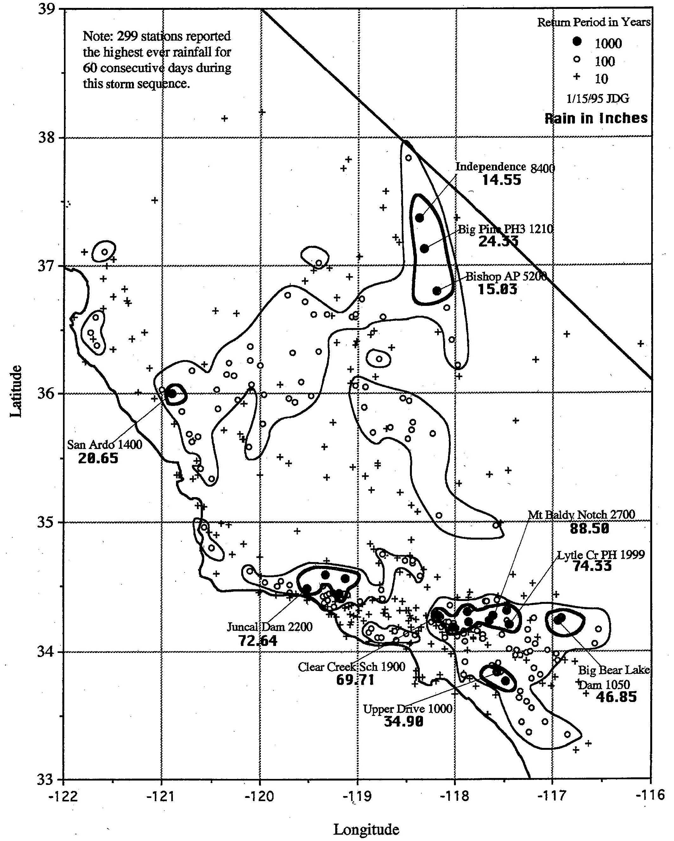
#1
1969 January - February
Notes:
The winter of 1969 was very wet in Southern California and the Southern Sierra Nevada. Southern California experienced some of the severest flooding since the 1930s. Property damage was extensive in the South Coastal Counties. Forty counties were declared disaster areas. 41 deaths were directly attributed to the storm. One of them was Mr. William Brooks the weather observer and dam tender at Jun-cal Dam on the Santa Ynez (Eenez) River in Santa Barbara County. His cabin was washed away on January 26 after he had measured 25.67 inches of rain.

Slide 23
#1
1969 January - February
Notes:
The winter of 1969 was very wet in Southern California and the Southern Sierra Nevada. Southern California experienced some of the severest flooding since the 1930s. Property damage was extensive in the South Coastal Counties. Forty counties were declared disaster areas. 41 deaths were directly attributed to the storm. One of them was Mr. William Brooks the weather observer and dam tender at Jun-cal Dam on the Santa Ynez (Eenez) River in Santa Barbara County. His cabin was washed away on January 26 after he had measured 25.67 inches of rain.

Slide 24
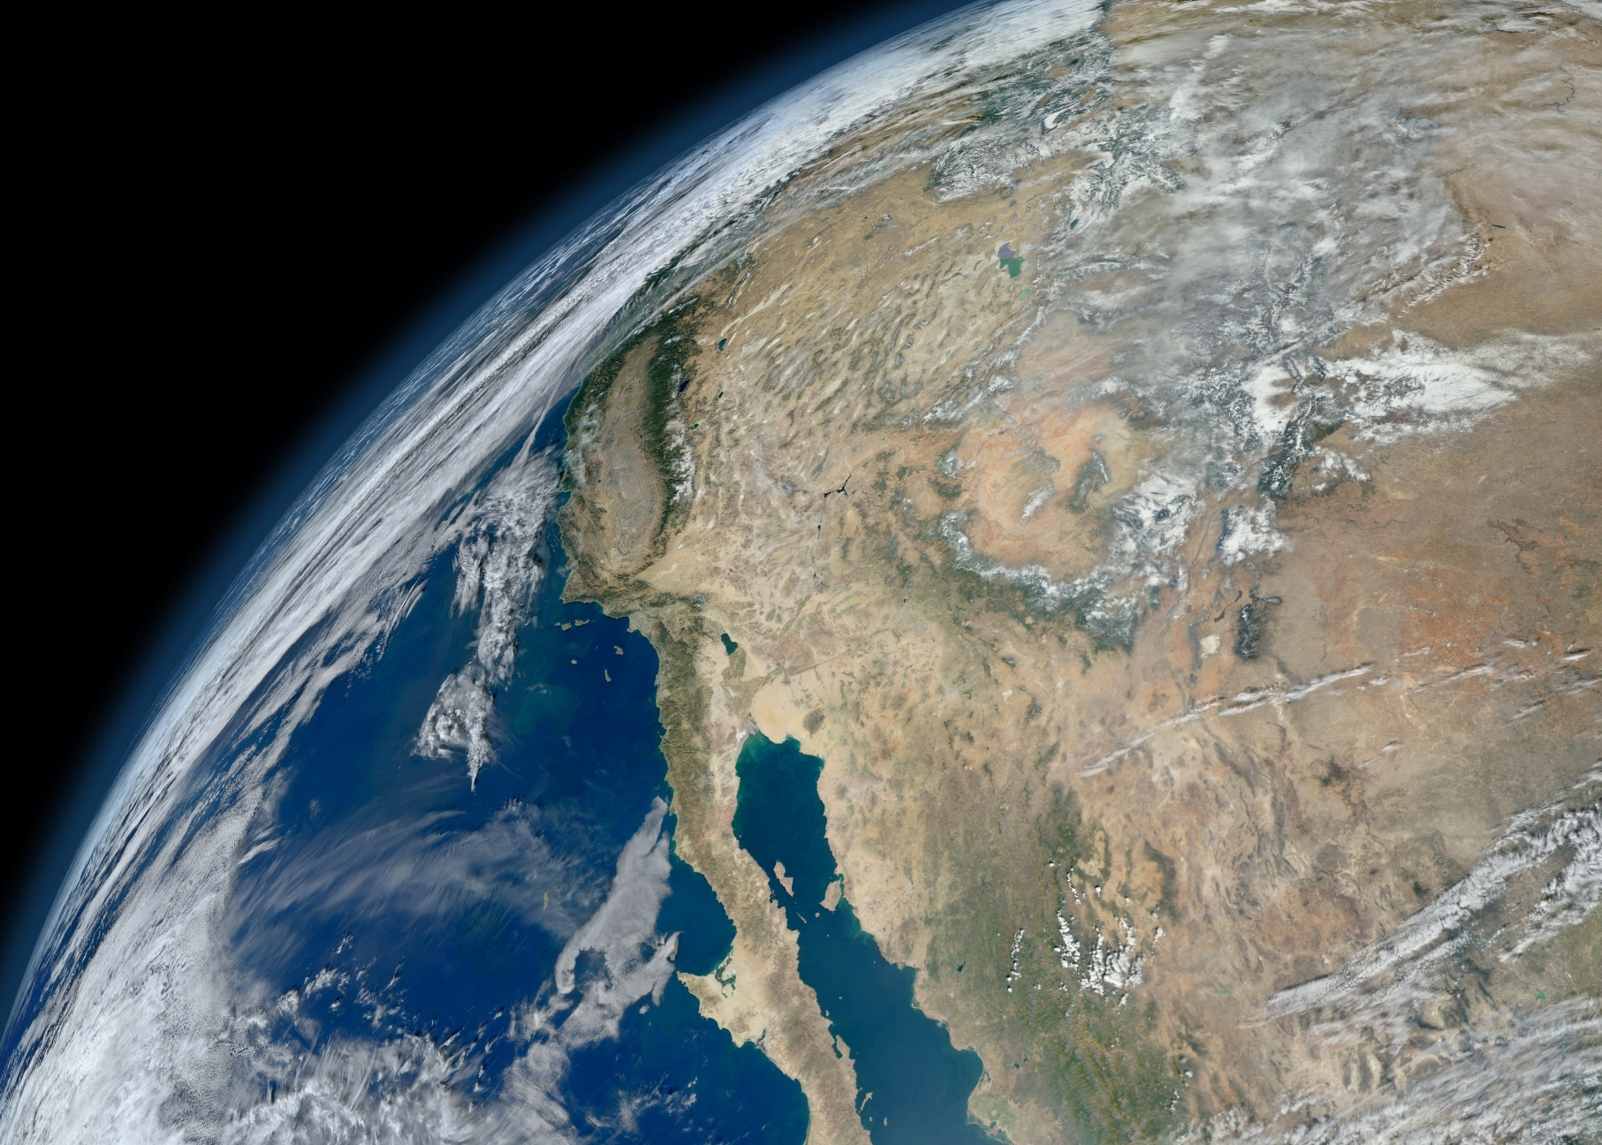
Atmospheric Rivers

Slide 25
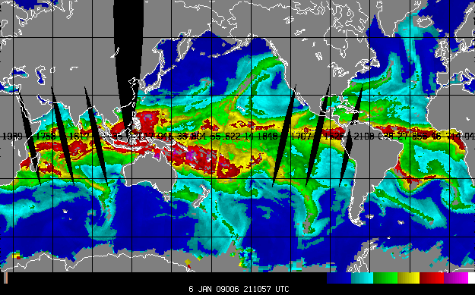
Satellite Observation of Water Vapor

Slide 26
2 Jan 1997 SSM/I satellite observations

Slide 27
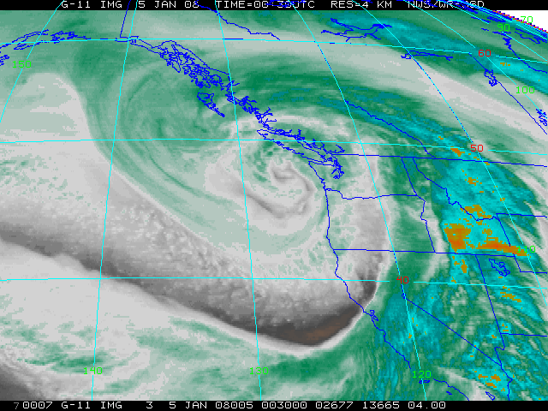
The Storm of 4-5 Jan 2008
Note that major impacts were focused >500 miles south of the Low pressure center in this storm.
This differs significantly from hurricanes, but the impacts are enormous and spread over a large area.
L
~500 miles
6-10 ft
snow
32 ft waves
7-13 in
rain
Atmospheric river
Geostationary Operational Environmental Satellites
(GOES) IR image of major West Coast storm
Time = 0030 UTC 5 January 2008
Low pressure center is off Washington coast

Slide 28
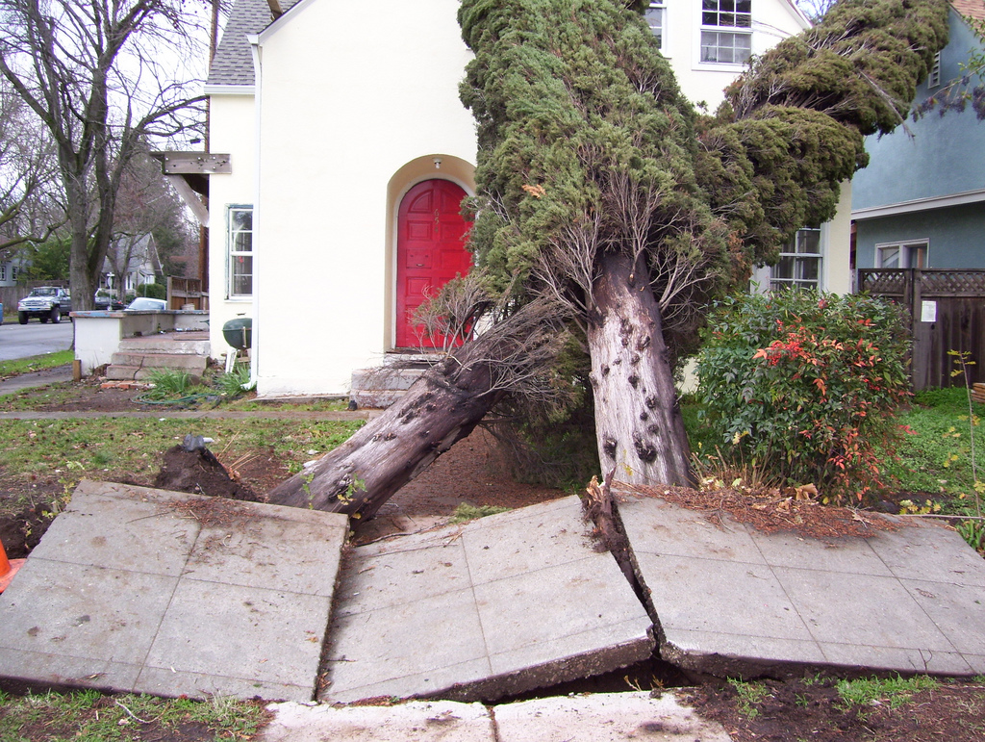
Notes:
East 8th Street Chico,ca

Slide 29
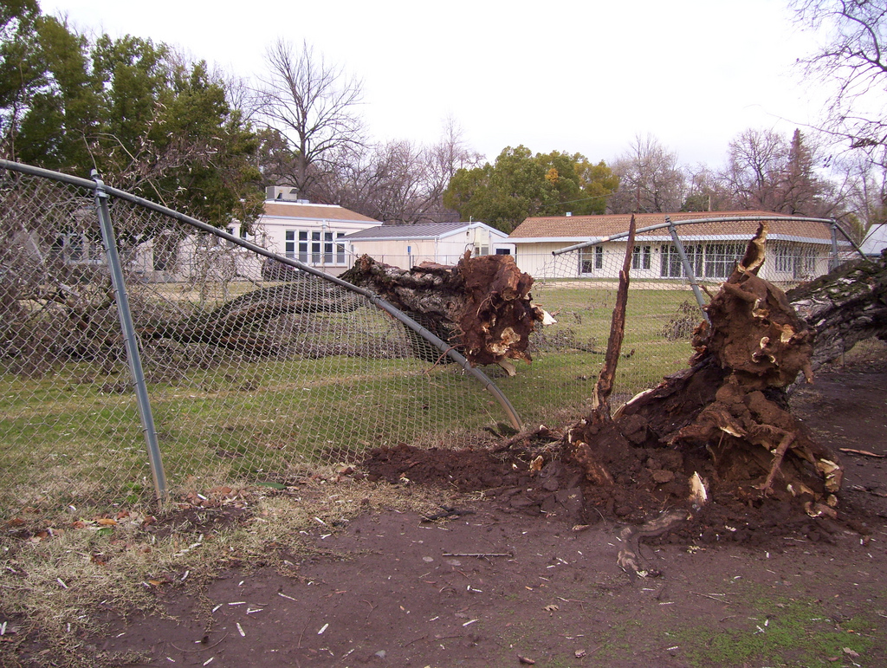
Notes:
East 8th Street Chico,ca

Slide 30
Maximum Return Period: 602 Years
Notes:
Sweeney Creek, Drainage Area North of Vacaville.

Slide 31
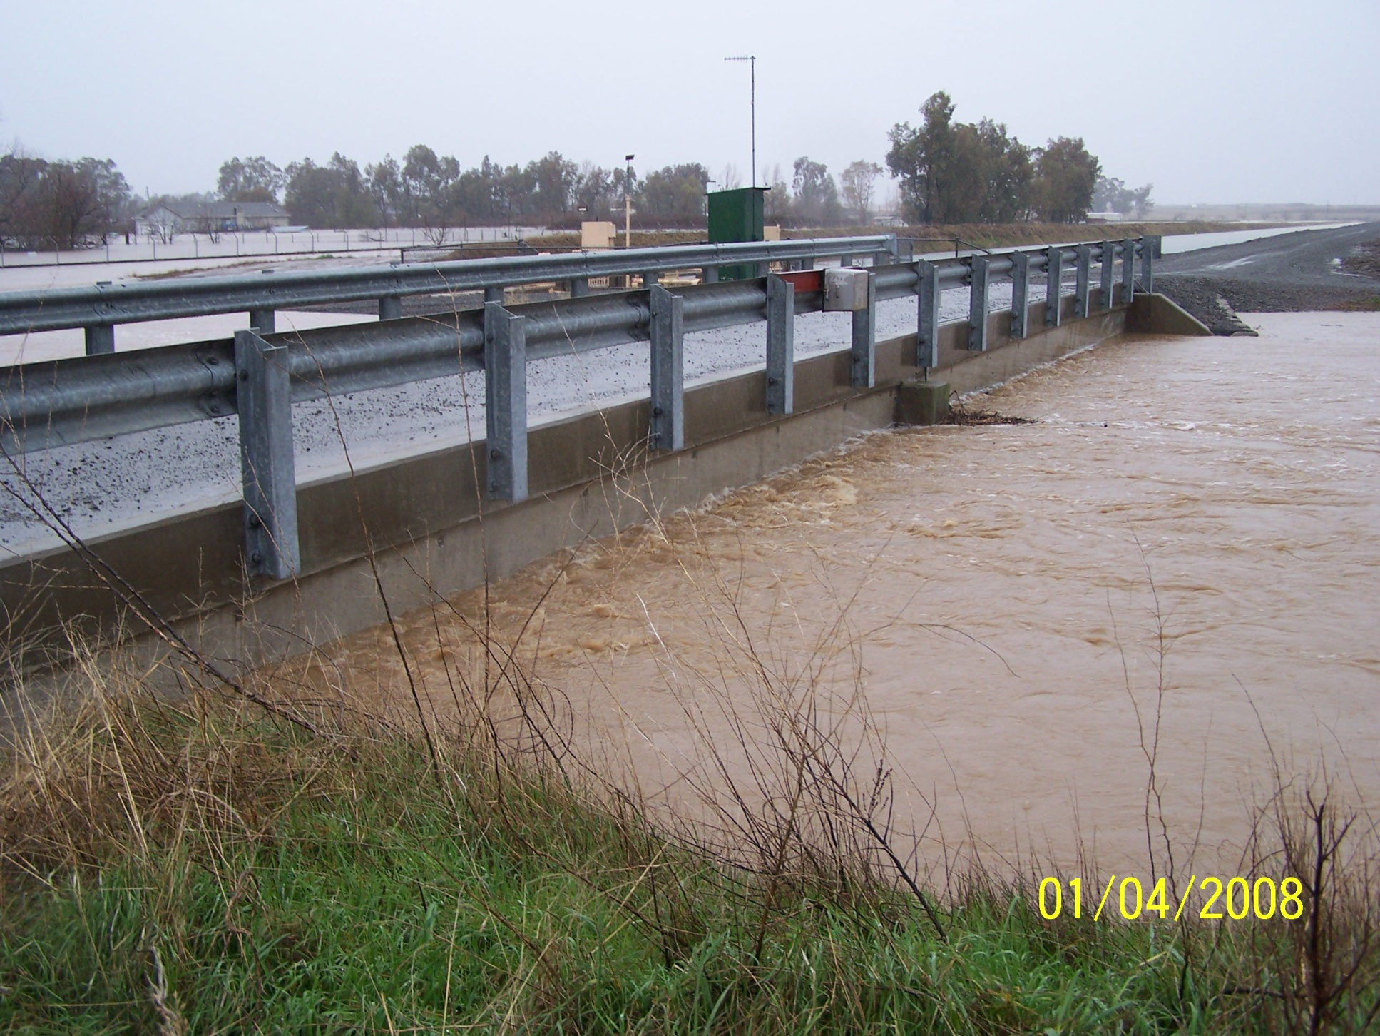

Slide 32
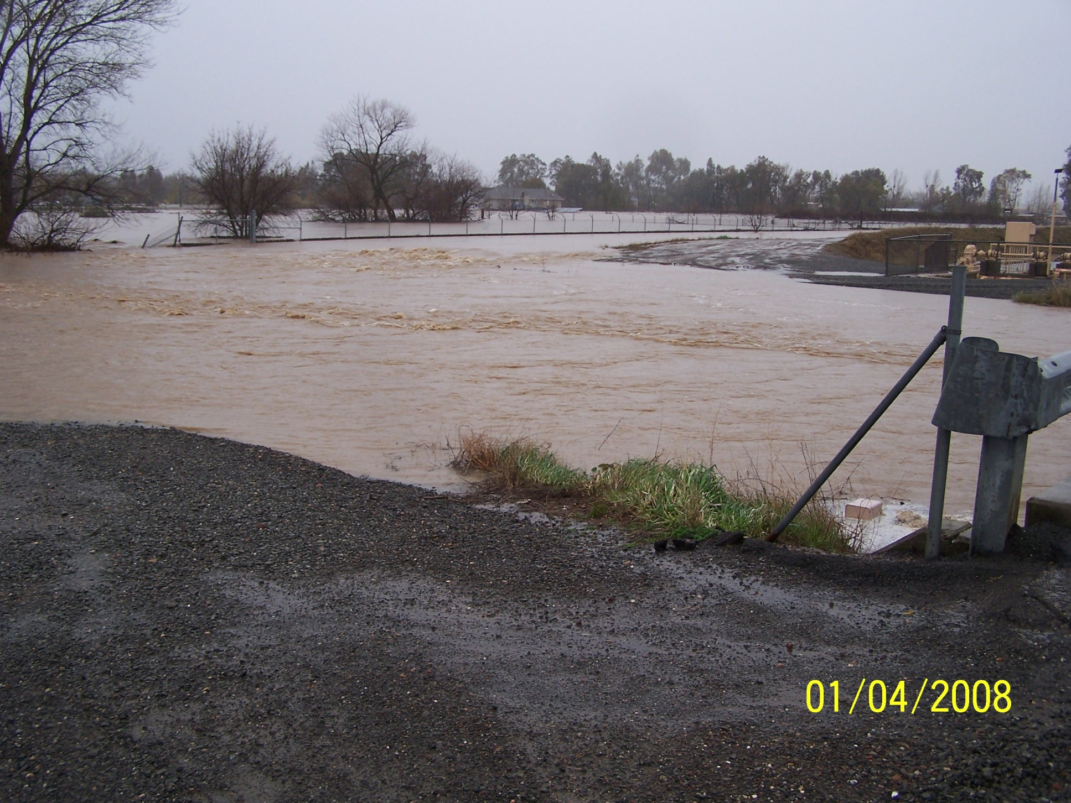

Slide 33
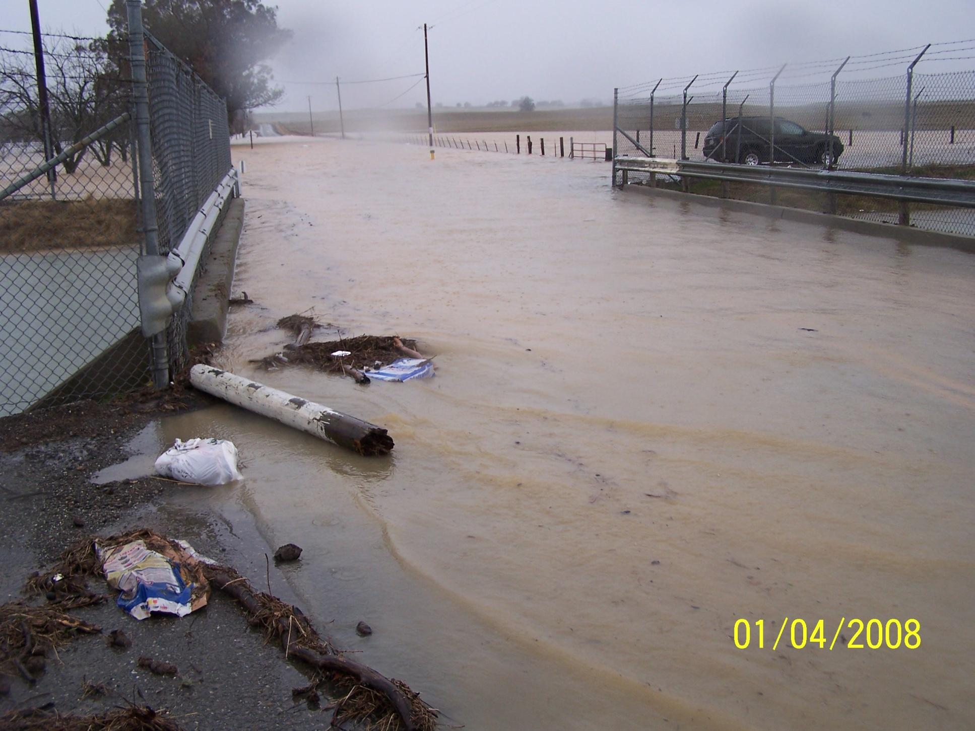

Slide 34
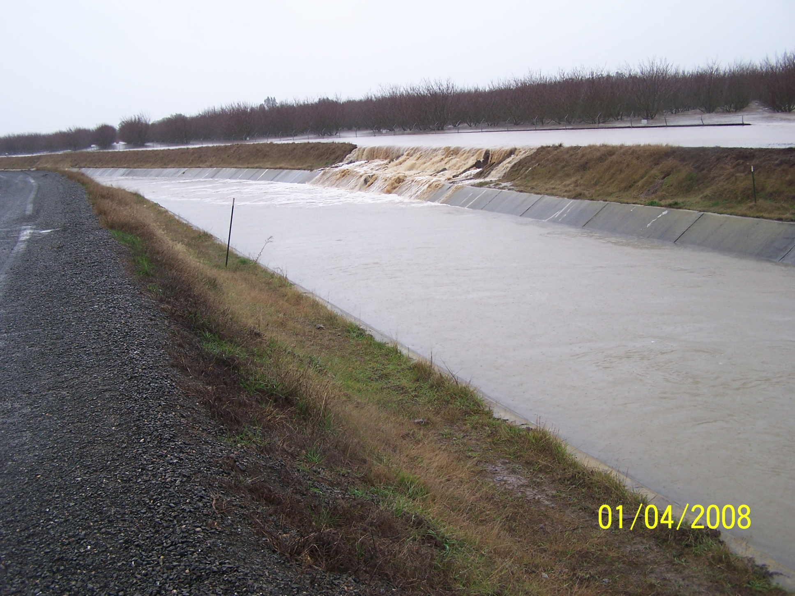

Slide 35
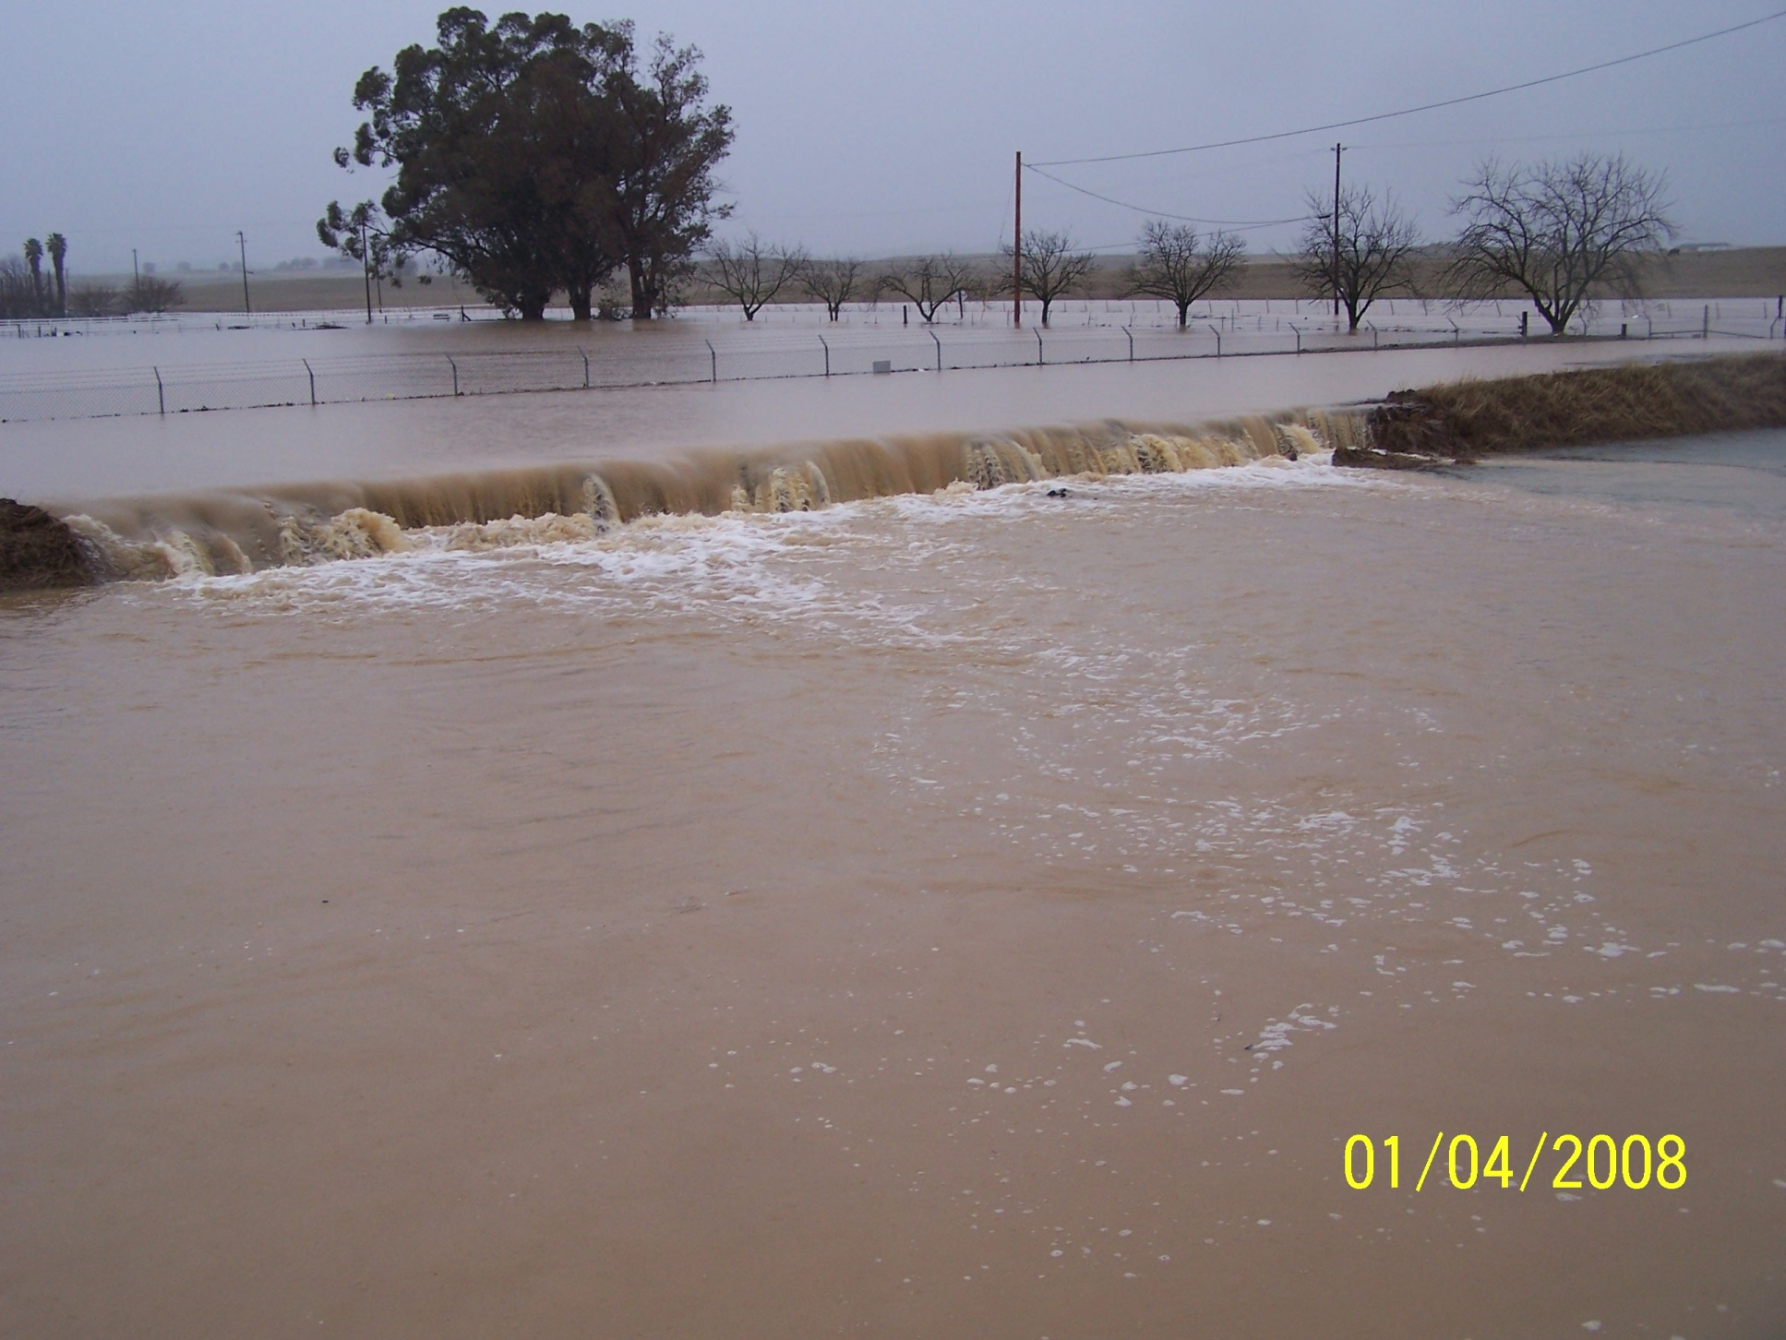

Slide 36
Key Phenomena Affecting California Water Supply/Flooding:
Cyclogensis
Flooding
Storm Track changes
L
Atmospheric
River
Tropical
Convection
ENSO
Easterly Wave
The most extreme CA storm would result from a rare alignment of key processes

Slide 37
IPCC 2100 Projections (From 4th Assessment Report 2007)
Global temp up 1.8 to 4.0°C (3 – 7° F) from 1990
Sea level rise by .18 to .59 m (.6 to 1.9 ft)
(with an added .1 to .2 m if Greenland ice melt increases beyond 1993-03 rate)
Precipitation more uncertain but likely increase at higher latitudes and near equator, less in subtropics
Extreme events (floods) more likely

Slide 38
Take Home Points
Atmospheric Rivers are important for floods and water supply
Alignment of processes necessary for extreme events
Extreme weather events have occurred in the recent past, with a short period of record, probability says we haven’t seen the “worst “ yet.

Slide 39
California Climate, Extreme Events and Climate Change Implications
Peter Coombe
Staff Environmental Scientist
CA Department of Water Resources
pcoombe@water.ca.gov

