Slide 1
Mapping Critical Infrastructure along the Sacramento River
A discussion

Slide 2
Definitions:
Critical Infrastructure: assets that are essential for the functioning of a society and economy (general reference definition)
Hard Points: Structures located adjacent to a river, such as buildings, bridges or levees, that change the direction or rate of channel migration by interfering with the river’s movement (SRCAF Handbook Glossary)
Notes:
Electricity generation, gas production, water supply, agriculture, heating, public health, transportation, security services

Slide 3
Purpose:
Sacramento River GIS A planning tool to help resolve questions as they arise at specific river locations.
Site-specific management plans
Hydrology & flooding
Ecological processes
Habitats
Current land use / Ownership
Infrastructure (Hard points?)
Context of entire subreach
Notes:
SRCAF Recommended actions to meet the goals of the SB1086 Program

Slide 5
Notes:
Aerial view of the Red Bluff Diversion Dam located about two miles southeast of Red Bluff, CA along the Sacramento River. (2004)

Slide 6
Notes:
Riprap along western bank (RM 182) placed in 2006

Slide 7
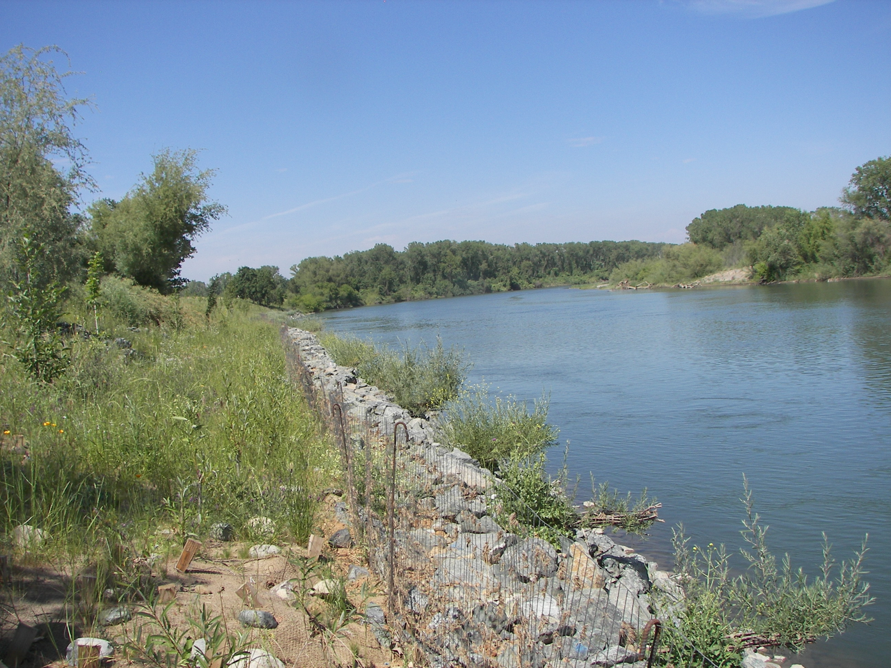

Slide 8
Revetment near RM 178-179 , Riparian Sanctuary
Notes:
Revetment

Slide 9
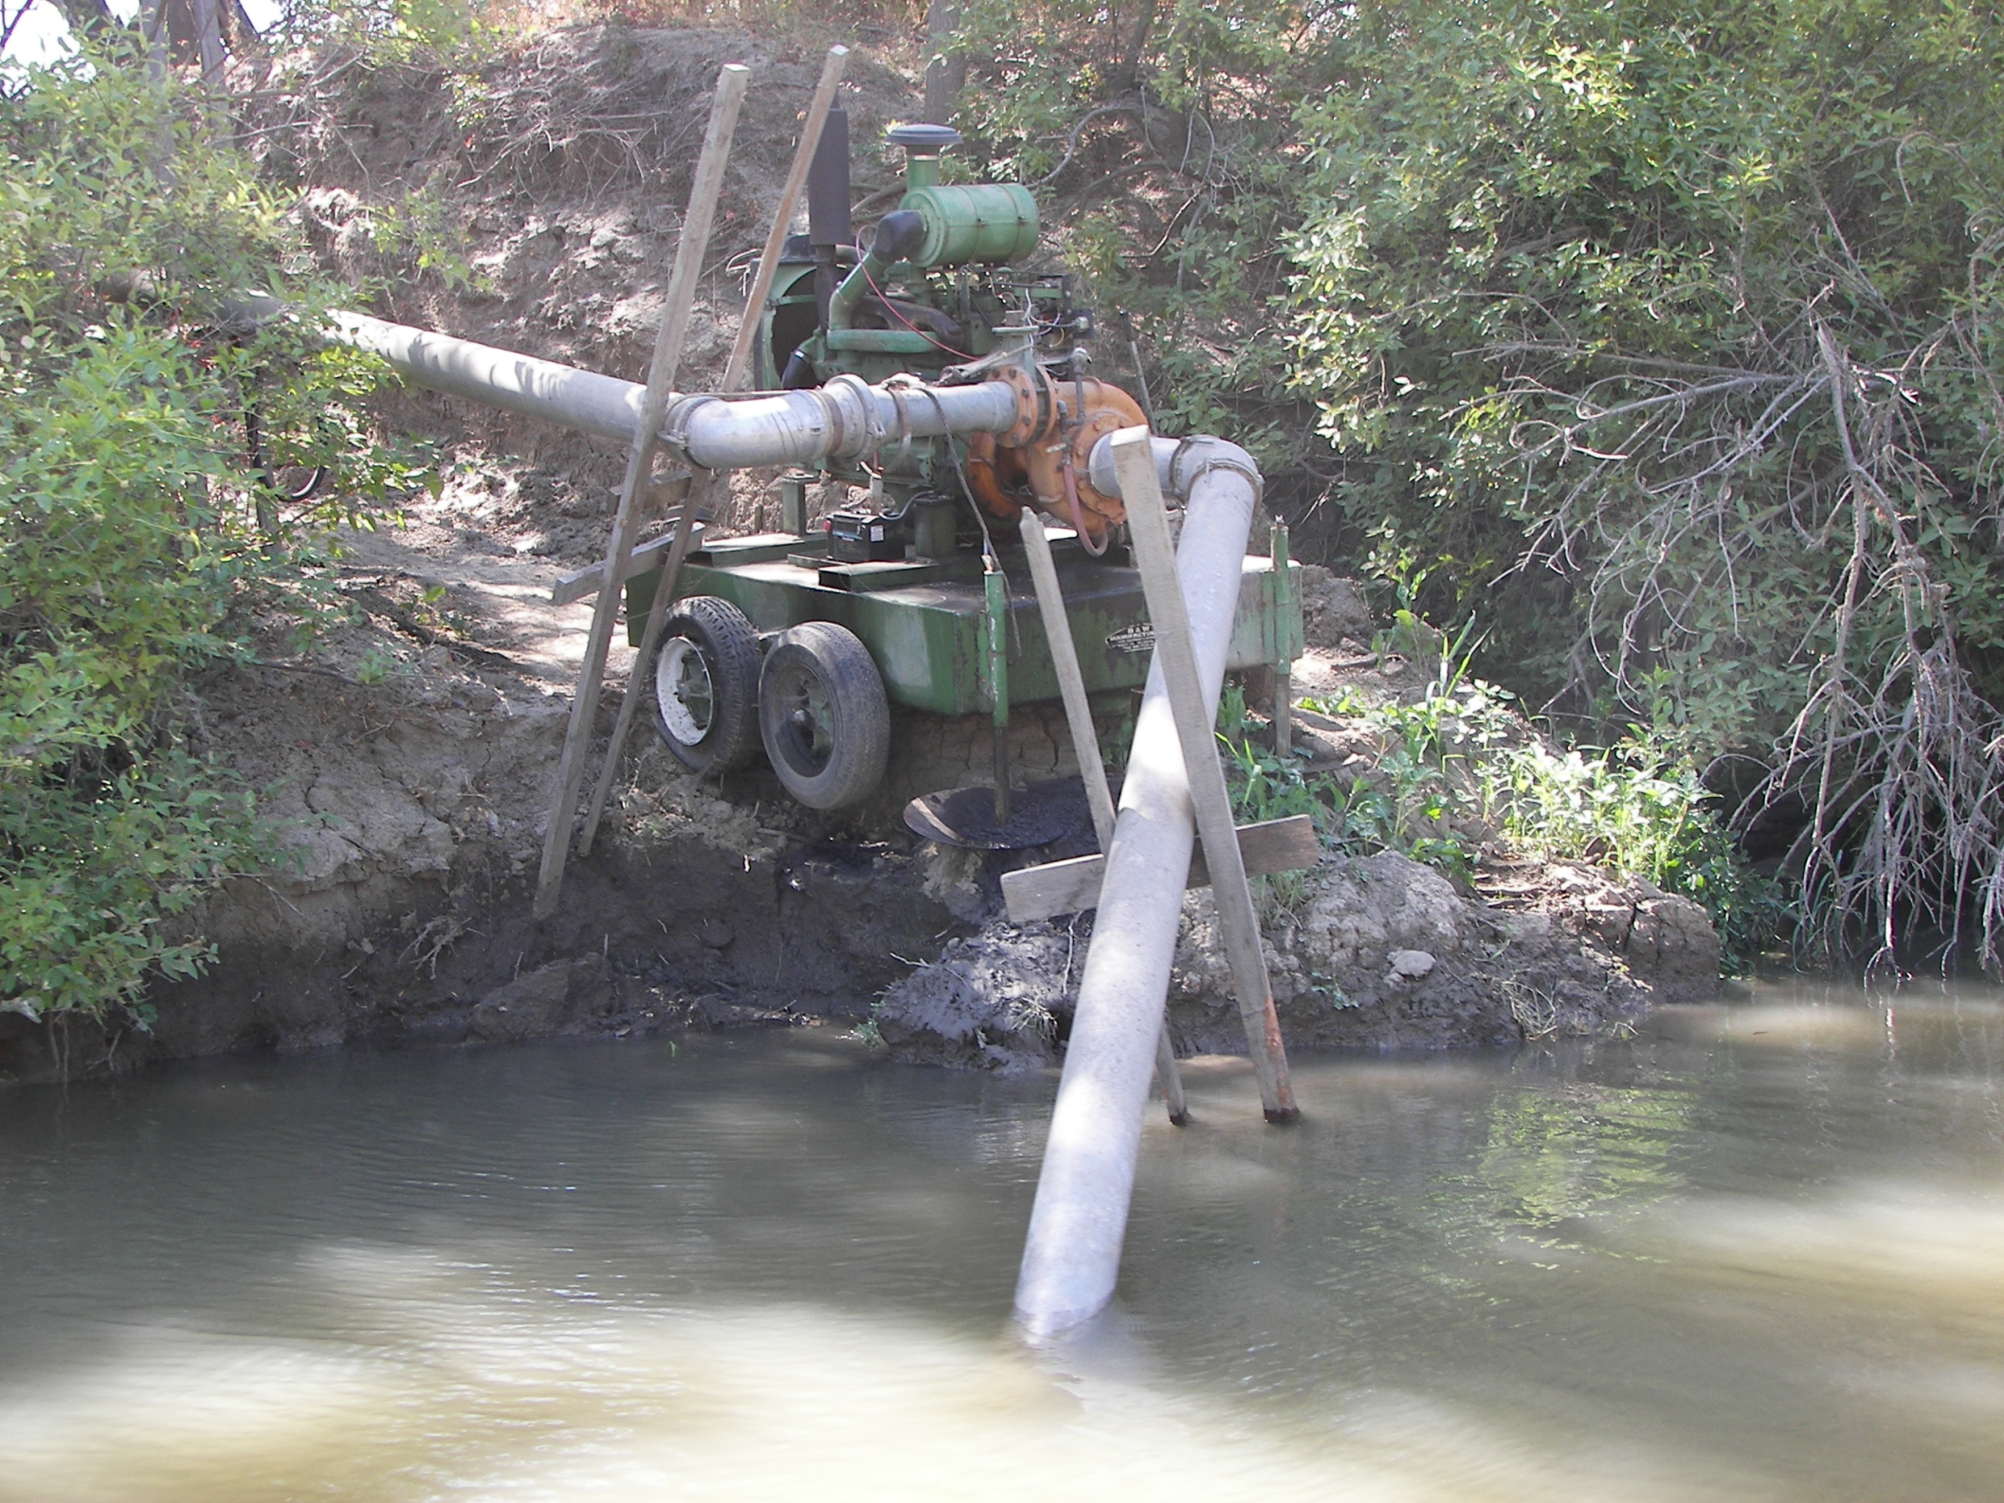

Slide 10
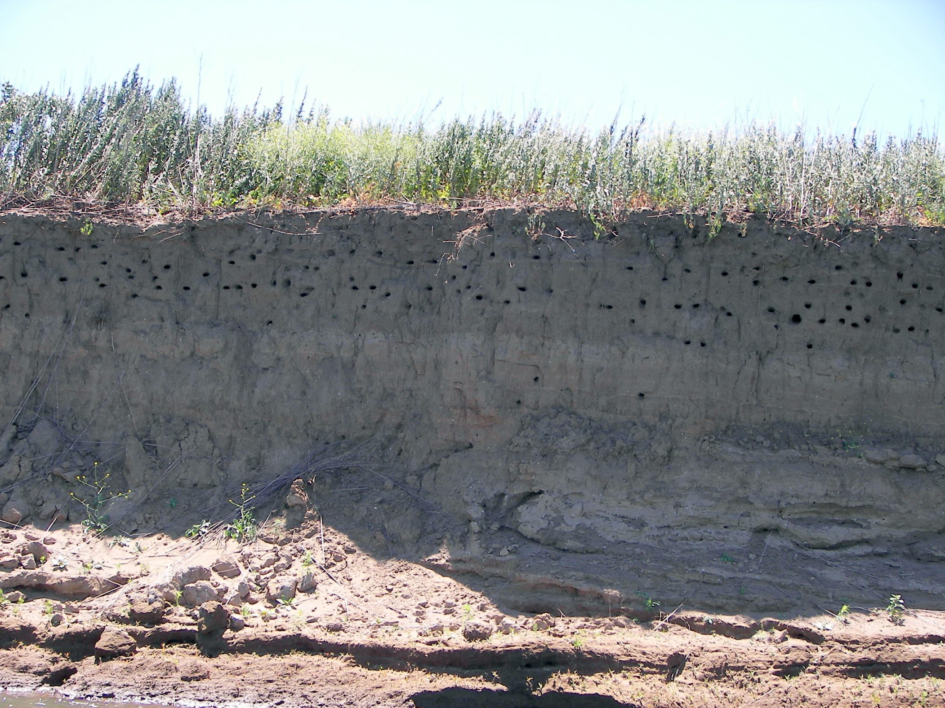

Slide 11
Infrastructure mapping currently available
Bank Protection: State, Federal, Local, private bank protection maintained by DWR?
Flood Control Structures: levees,
Water Diversions: DFG’s Inland Fisheries Division maintains agricultural water diversion data
Highways, Roads, Railroads: Mapping maintained by US Department of transportation

Slide 12
What infrastructure has not been mapped but should be?
rirwin@water.ca.gov
Notes:
the Committee asked that each county provide a list of proposed “Hard Points” within the Conservation Area in their county. Examples could be, but at this time are not limited to---cities, bridges, authorized flood control structures, or major facilities such as pumping plants, that have a public investment or public safety component. This is not intended to be a comprehensive list, but just a working point from which the TAC may use for their discussions.

