Slide 1
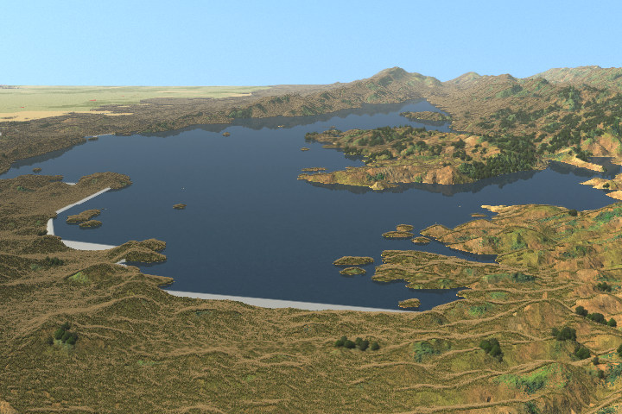
North-of-the-Delta
Offstream Storage
Sacramento River Conservation Area Forum TAC
May 3, 2011
State of California
Department of Water Resources
U.S. Department of the Interior
Bureau of Reclamation

Slide 2
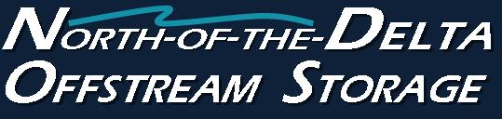
Outline
Introduction
NODOS Investigation History:
  CALFED and NODOS
  Flow Regime TAG
Project Overview:
  Alternatives Considered
  Alternatives to be Evaluated In Detail
NODOS Operations and Operational Modeling
  Some Results
  Other Models
Schedule
Contact Information

Slide 3
CALFED and Storage
“All aspects … are interrelated and interdependent.”
“The success of all of the elements depends upon expanded and more strategically managed storage.”
CALFED: Initial Surface Storage Screening
CALFED ROD: 5 surface storage projects
Acceptable surface storage projects support CALFED Program objectives
Storage provides needed system flexibility

Slide 4
NODOS Objectives
Water Supply Reliability – agricultural, urban,
refuge, and emergency response
Anadromous Fish and Other Aquatic Species Survival
Delta Water Quality
Flexible hydropower generation to support renewable integration
Recreation
Flood Damage Reduction

Slide 5
Sacramento River Flow Regime
Stakeholder participants identified the flow regime of the Sacramento River as one of the primary areas of concern related to potential implementation impacts.
Early conceptual formulations of a NODOS project conceived that the flow regime and associated ecosystem processes of the river could be improved with an offstream storage facility.”

Slide 6
Investigation requested formation of a Technical Advisory Group to …
Identify potential NODOS flow regime impacts and improvements
Further the general understanding of Sacramento River flow regime
Notes:
As a result …

Slide 7
TAG Participation
Friends of the River
Sacramento River Conservation Area Forum
Sacramento River Preservation Trust
Tehama-Colusa Canal Authority
The Bay Institute
The Natural Heritage Institute
The Nature Conservancy
University of California at Davis
California Bay-Delta Authority
U.S. Bureau of Reclamation
NOAA Fisheries
Department of Fish and Game
Department of Water Resources
U.S. Fish and Wildlife Service
U.S Army Corps of Engineers
DWR/COE Comprehensive Studies
CH2MHill
Metropolitan Water District of So California
State Water Contractors
Orland Unit Water User’s Association
Notes:
We received broad and diverse support to form the TAG
Current distribution list includes 50 participants (about half participated regularly)
Successes of the TAG are largely due to the input and commitment of members

Slide 8
TAG Identified Flow Regime Improvement Opportunities
Increase peak flows during Winter / Spring to support physical river functions
Restore Spring snowmelt pattern to support cottonwood success
Stabilize Fall flows to avoid stranding and desiccation
Increase Spring flow duration in Yolo Bypass
Reduce diversions
Improve river temperatures for salmonids
Notes:
Among many other efforts, Five specific opportunities
Associated with channel formation and river meander processes – ability to reoperate Shasta and the river by increasing flood flows is extremely limited by flood management requirements
Associated with improved riparian cohort success (esp. cottonwood)
Associated with supporting anadromous fish survival (esp. dewatering of salmon redds)
Associated with supporting Splittail survival through expansion of wetted area
Associated with reducing diversions from the Sacramento River during critical fish periods
The final four have been incorporated in recent operations simulations to determine ability of NODOS to improve Sac R flow regime

Slide 9
What we wanted from TAG
Help identify Ecosystem Restoration benefits of NODOS
Help develop operational guidance for NODOS diversions

Slide 10
Flow Regime TAG also Suggested
An assessment of the river’s flow regime using a shorter time-step than CALSIM II (monthly)
Consideration of additional tools to describe effects of the project
Consideration of the CALFED Ecosystem Restoration Program

Slide 11
Alternatives Considered
Red Bank Reservoir (and others within Cottonwood Creek watershed)
Newville Reservoir
Colusa Reservoir
Sites Reservoir

Slide 12
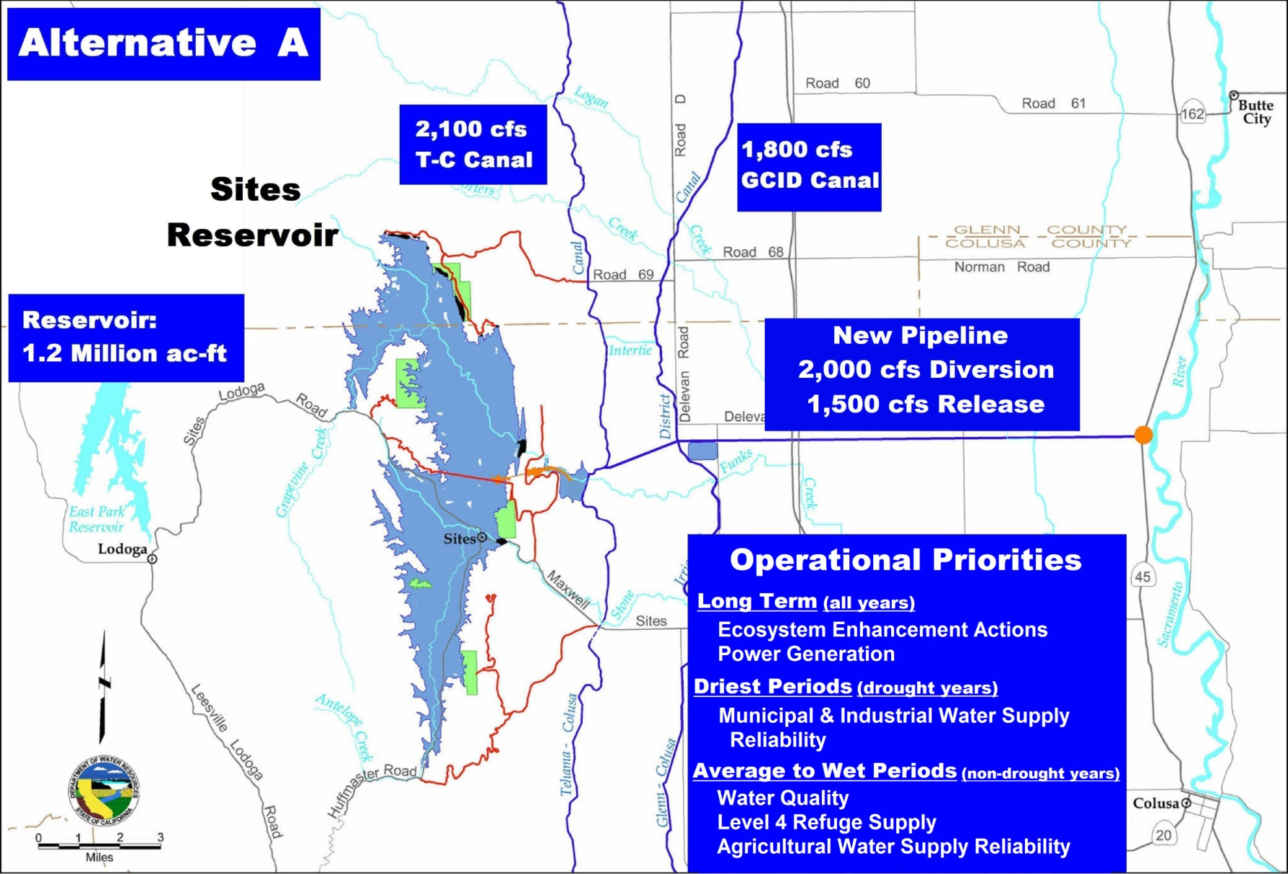
Alternatives for Detailed Evaluation:

Slide 13

Alternatives for Detailed Evaluation:

Slide 14

Alternatives for Detailed Evaluation:

Slide 15
Ecosystem Enhancement Account
Formulation:
Includes specific water-dependent restoration actions
Account actions from CALFED Ecosystem Restoration Program list and input from Sacramento River Flow Regime TAG and Agencies
Integrated with other project objectives
Adaptive management
Notes:
…beyond regulatory requirements and system capability
Actions selected from…
Input From…

Slide 16
Ecosystem Enhancement Actions (EEA) Included in Alternatives:
Improve the reliability of coldwater pool storage in Shasta Lake
Provide releases from Shasta Dam to improve Sacramento River water temperatures in during Below Normal, Dry and Critical water year types
Improve the reliability of coldwater pool storage in Folsom Reservoir to maintain or improve water temperatures in the lower American River, May through November – all year types
Provide supplemental Delta outflow during summer and fall months to improve X2 (if possible, west of Collinsville, 81 km)
Improve the reliability of coldwater pool storage in Lake Oroville to improve water temperature from May through November during all water year types
Stabilize flows in the Sacramento River between Keswick Dam and the Red Bluff Diversion Dam particularly during fall months
Provide increased flows from spring through fall in the lower Sacramento River by reducing diversions at Red Bluff and at Hamilton City

Slide 17
Assumptions for Modeling of NODOS Alternatives
The assumptions for the Existing Conditions and No Action Alternative include the 2008 and 2009 Biological Opinions
Red Bluff Fish Passage Improvement Project is assumed to be implemented in the No Action Alternative
Climate change will be evaluated in a sensitivity analysis

Slide 18
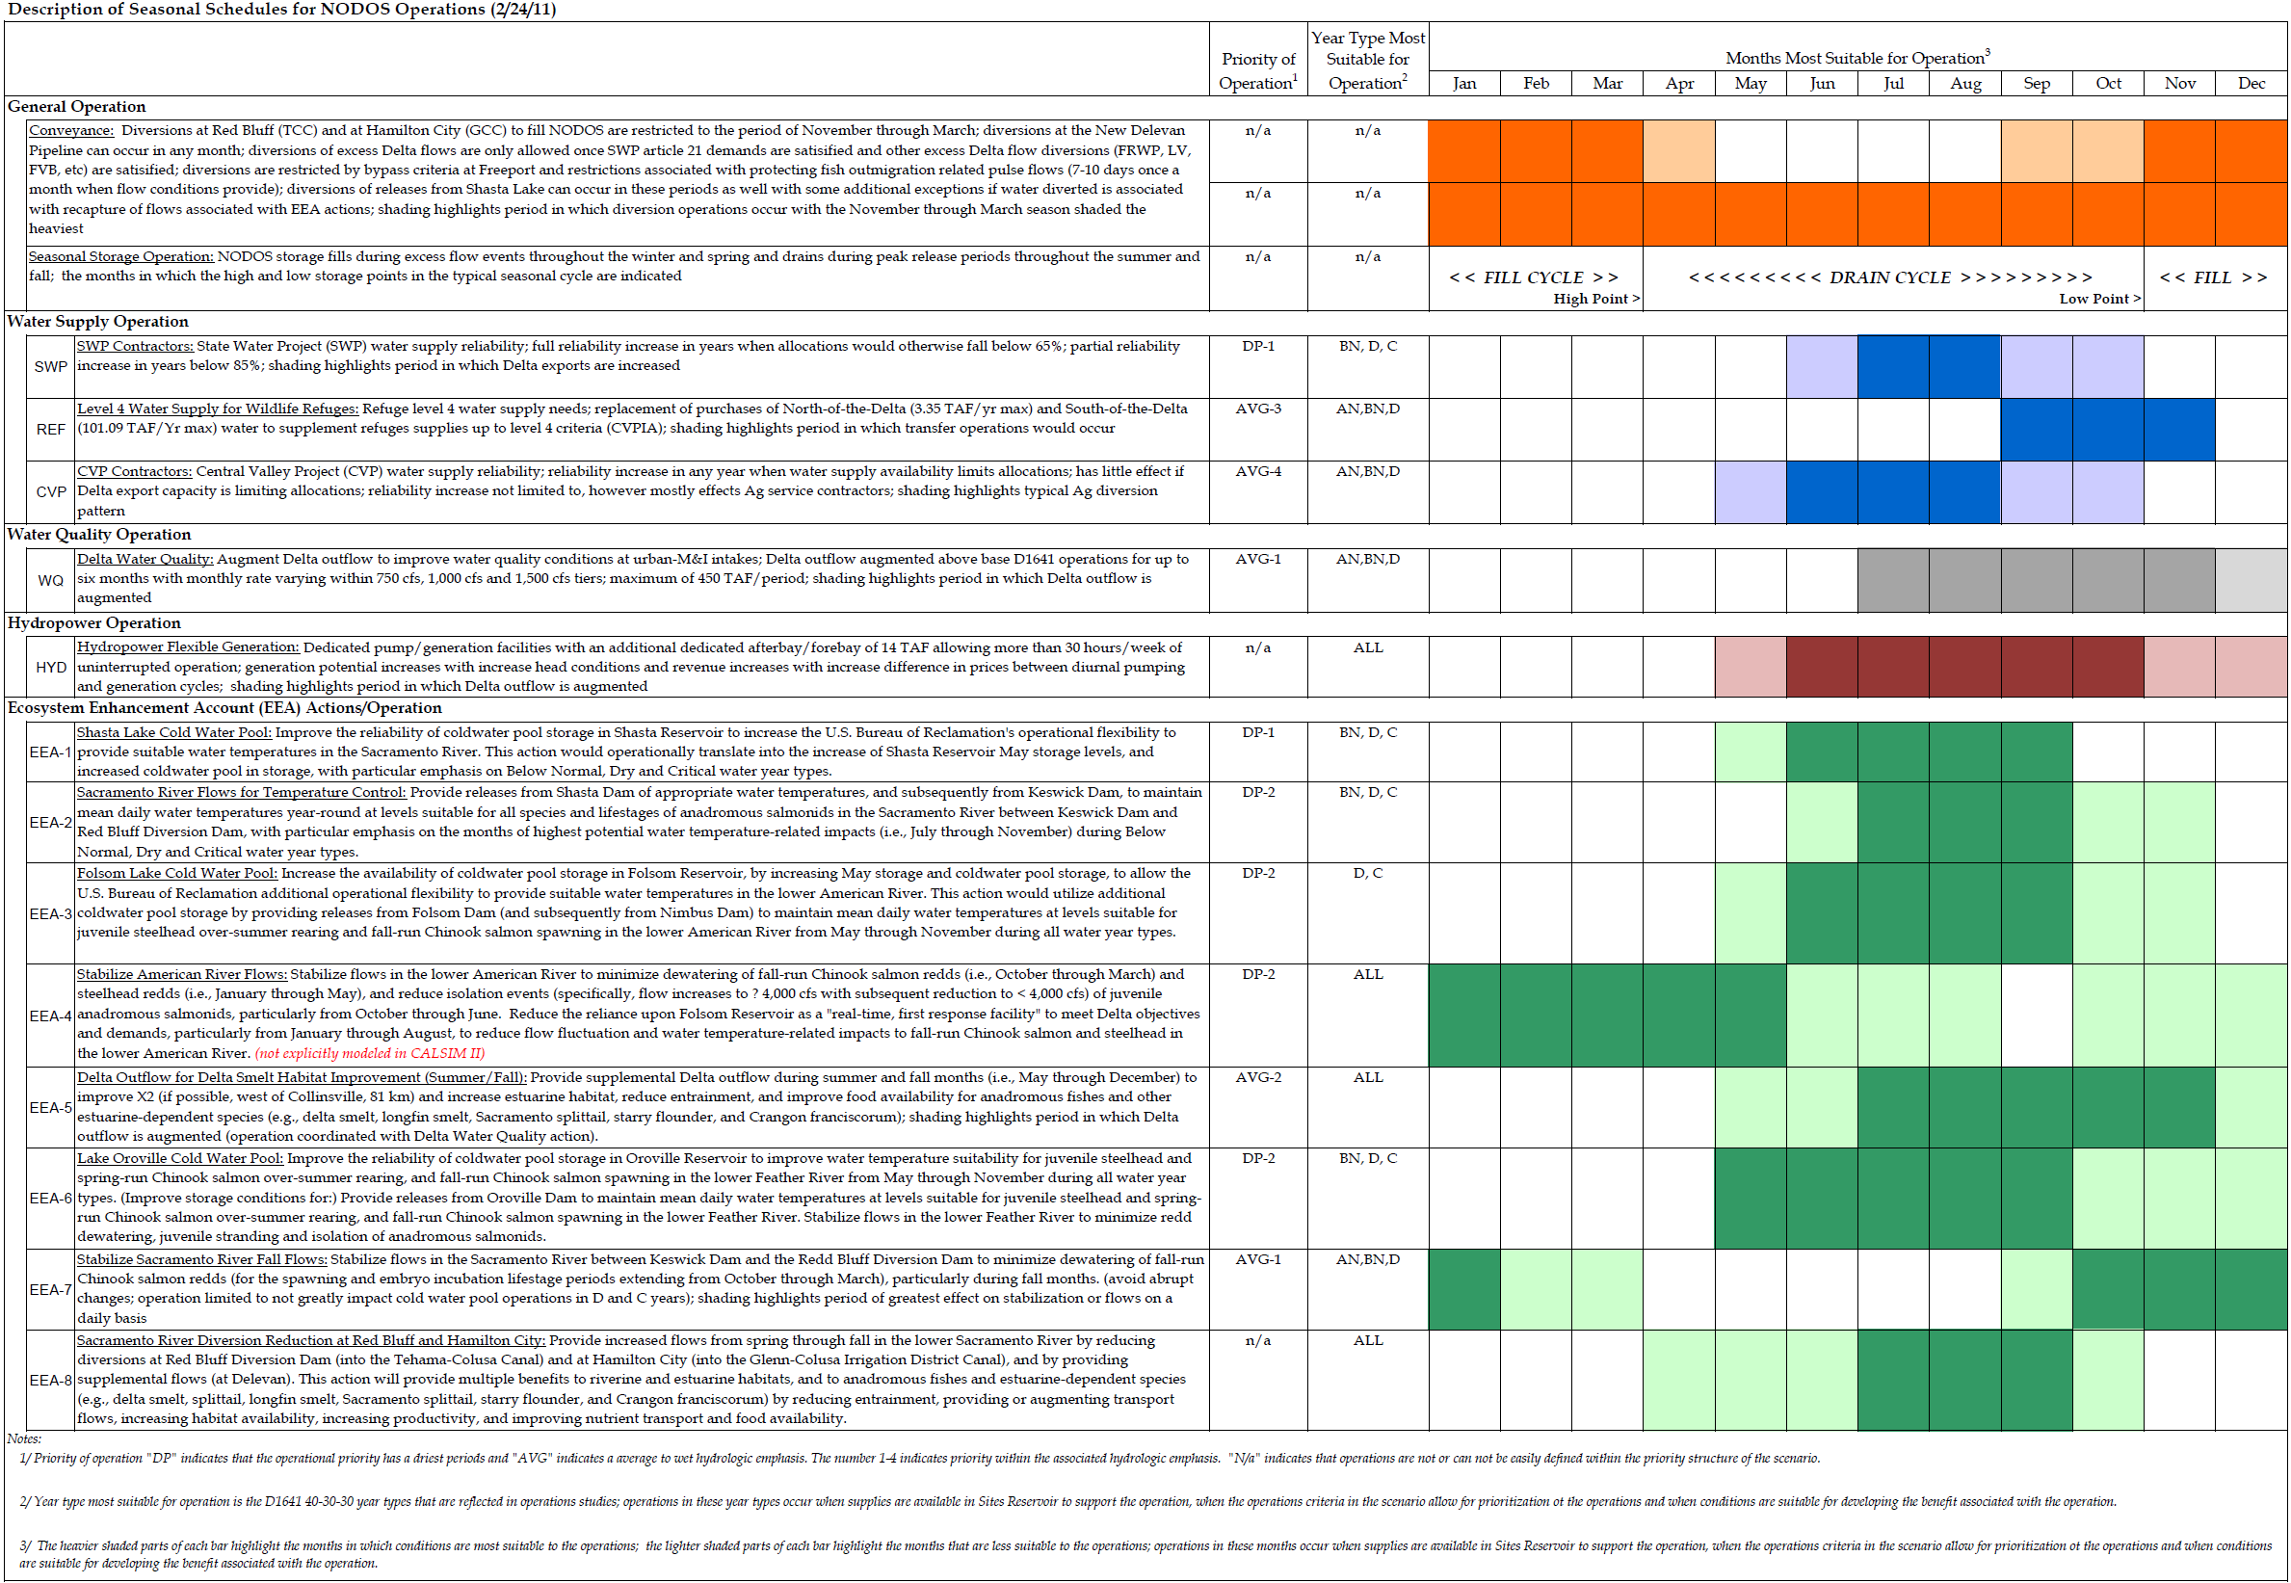
NODOS Operational Schedule

Slide 19
Assumptions Regarding NODOS Intake Operations
NODOS diversions are coordinated with those of existing users of Tehama-Colusa Canal and Glenn-Colusa Irrigation District Canal
Operations and Maintenance is scheduled based upon needs at each diversion location

Slide 20
Assumptions Regarding NODOS Intake Operations
Diversions to storage are restricted until bypass requirements achieved (must be met for diversion to storage to occur)
  Below Hamilton City: 4,000 cfs (3 day average)
  At Wilkens Slough: 5,000 cfs (3 day average)
  At Freeport/Hood (average monthly):
    15,000 cfs in January
    13,000 cfs in December or Febraury through June
    Otherwise 11,000 cfs
Diversions to storage restricted to protect potential pulse events
  Up to one pulse event per month (October – May)
  Pulse range 15,000 cfs – 25,000 cfs (based on Bend Bridge as indicator)
  Pulse event qualified if duration of seven days
  Diversions not restricted once pulse event not qualified (not in range or event already occurred)

Slide 21
Example of Pulse Protection

Slide 22
Sample Results
From NODOS Alternatives

Slide 23
System Flexibility: Total Storage of Trinity, Shasta, Oroville, Folsom and NODOS

Slide 24
Total Diversions and Releases

Slide 25
Diversions at Red Bluff, Hamilton City and Delevan Pipeline

Slide 26
Cold Water Pool Management
Shasta Lake End-of-Month Storage

Slide 27
Sacramento River Temperature at Bend Bridge
Temperature
(degrees F)

Slide 28
Stability Flows: Sacramento River Flow below Keswick Dam

Slide 29
Water Supply Reliability

Slide 30
Delta Water Quality Improvement
EC

Slide 31
Alternatives Performance

Slide 32
Modeling Status and Ongoing Activities

Slide 33
  Analytical Framework –
  System (feasibility, system-level impacts)
Climate Change Modified Hydrology
Sea Level Rise
VIC, ANN
Hydrology &
System Operations
CALSIM II, USRDOM
Reservoir/River Temp
USRWQM,
Reclamation Temperature
Water supply impacts, river flows, exports, storage
Power
LTGEN,
SWP Power,
NODOS Power
Reservoir, River temperatures
Net Generation and Use
Delta Hydrodynamics
DSM2-HYDRO
Delta channel flows, stages, velocities
Fisheries
Reclamation Mortality, SALMOD,
WRCLCM (IOS)
Economics
SWAP,
LCPSIM/SUPEM, LCRBWQM/SBWQM
Survival, Potential Production, Population
Quantification of
Economic Benefits
Delta Water Quality
DSM2-QUAL
Salinity (EC, Cl, TDS, Br) and fingerprinting (EC, volume)

Slide 34
  Analytical Framework –
  Local (local watershed impacts)
Surface Water Resources
Surface Water Quality
CALSIM II
Monthly
storage, flow &
diversion operations
USRDOM
Daily storage, Sac River
and tributary flow &
diversion operations
USRWQM
Daily Sacramento River
Temperature
Other Quantitative and Qualitative Analyses
CAL2DOM
Fluvial Geomorphology and Riparian Habitat
Aquatic Biological Resources
SRH-2D
Local Vel. Scour, & Stage
RHEM
Riparian Veg. Growth
WRCLCM
(IOS/DPM Model)
Sacramento River
Winter Chinook
SALMOD
Sacramento River
Fall, Late-Fall, Winter &
Spring Chinook
SRH-SIAM Sediment Loads
SAC-EFT
Sacramento River
Chinook salmon, steelhead, green sturgeon, bank swallow, western pond turtle
Other Quantitative and Qualitative Analyses
SRH-Meander
Point Bar Growth
SRH-1DV
Riparian Veg. Survival

Slide 35
Schedule
Public Draft NODOS EIR / EIS and Feasibility Study Report
December 2011
Final Draft NODOS EIR / EIS and Feasibility Study Report
December 2012

Slide 36
Contacts
Jim Wieking
Department of Water Resources
P.O. Box 942836
Sacramento CA 94236
916-651-9279
jwieking@water.ca.gov
Sharon McHale
Bureau of Reclamation
2800 Cottage Way, MP-700
Sacramento CA 95825
916-978-5086
smchale@usbr.gov
Project Websites:
www.storage.water.ca.gov/northdelta/index.cfm
www.usbr.gov/mp/nodos/index.html

