Slide 2
Redd Dewatering
Monitoring and Assessment on the Sacramento River

Slide 4
What is redd dewatering?
Conditions that cause redd dewatering?
Dewatering Monitoring and Assessment

Slide 5
Study Question
What percentage of fall-run redds are being dewatered while eggs and fry are still in the gravel?

Slide 6
Keswick Dam
STUDY AREA
Sacramento River
Redding to Los Molinos
About 70 miles of River
Redding
5
Anderson
5
Bend
Red Bluff
N
5
Los Molinos

Slide 7
Sacramento River Fall-run Spawning Life History
Fall-run Spawning
Eggs and Fry in Gravel - 60 to 90 days
Oct
Nov
Dec
Jan
Feb
Mar

Slide 8
Flow

Slide 11
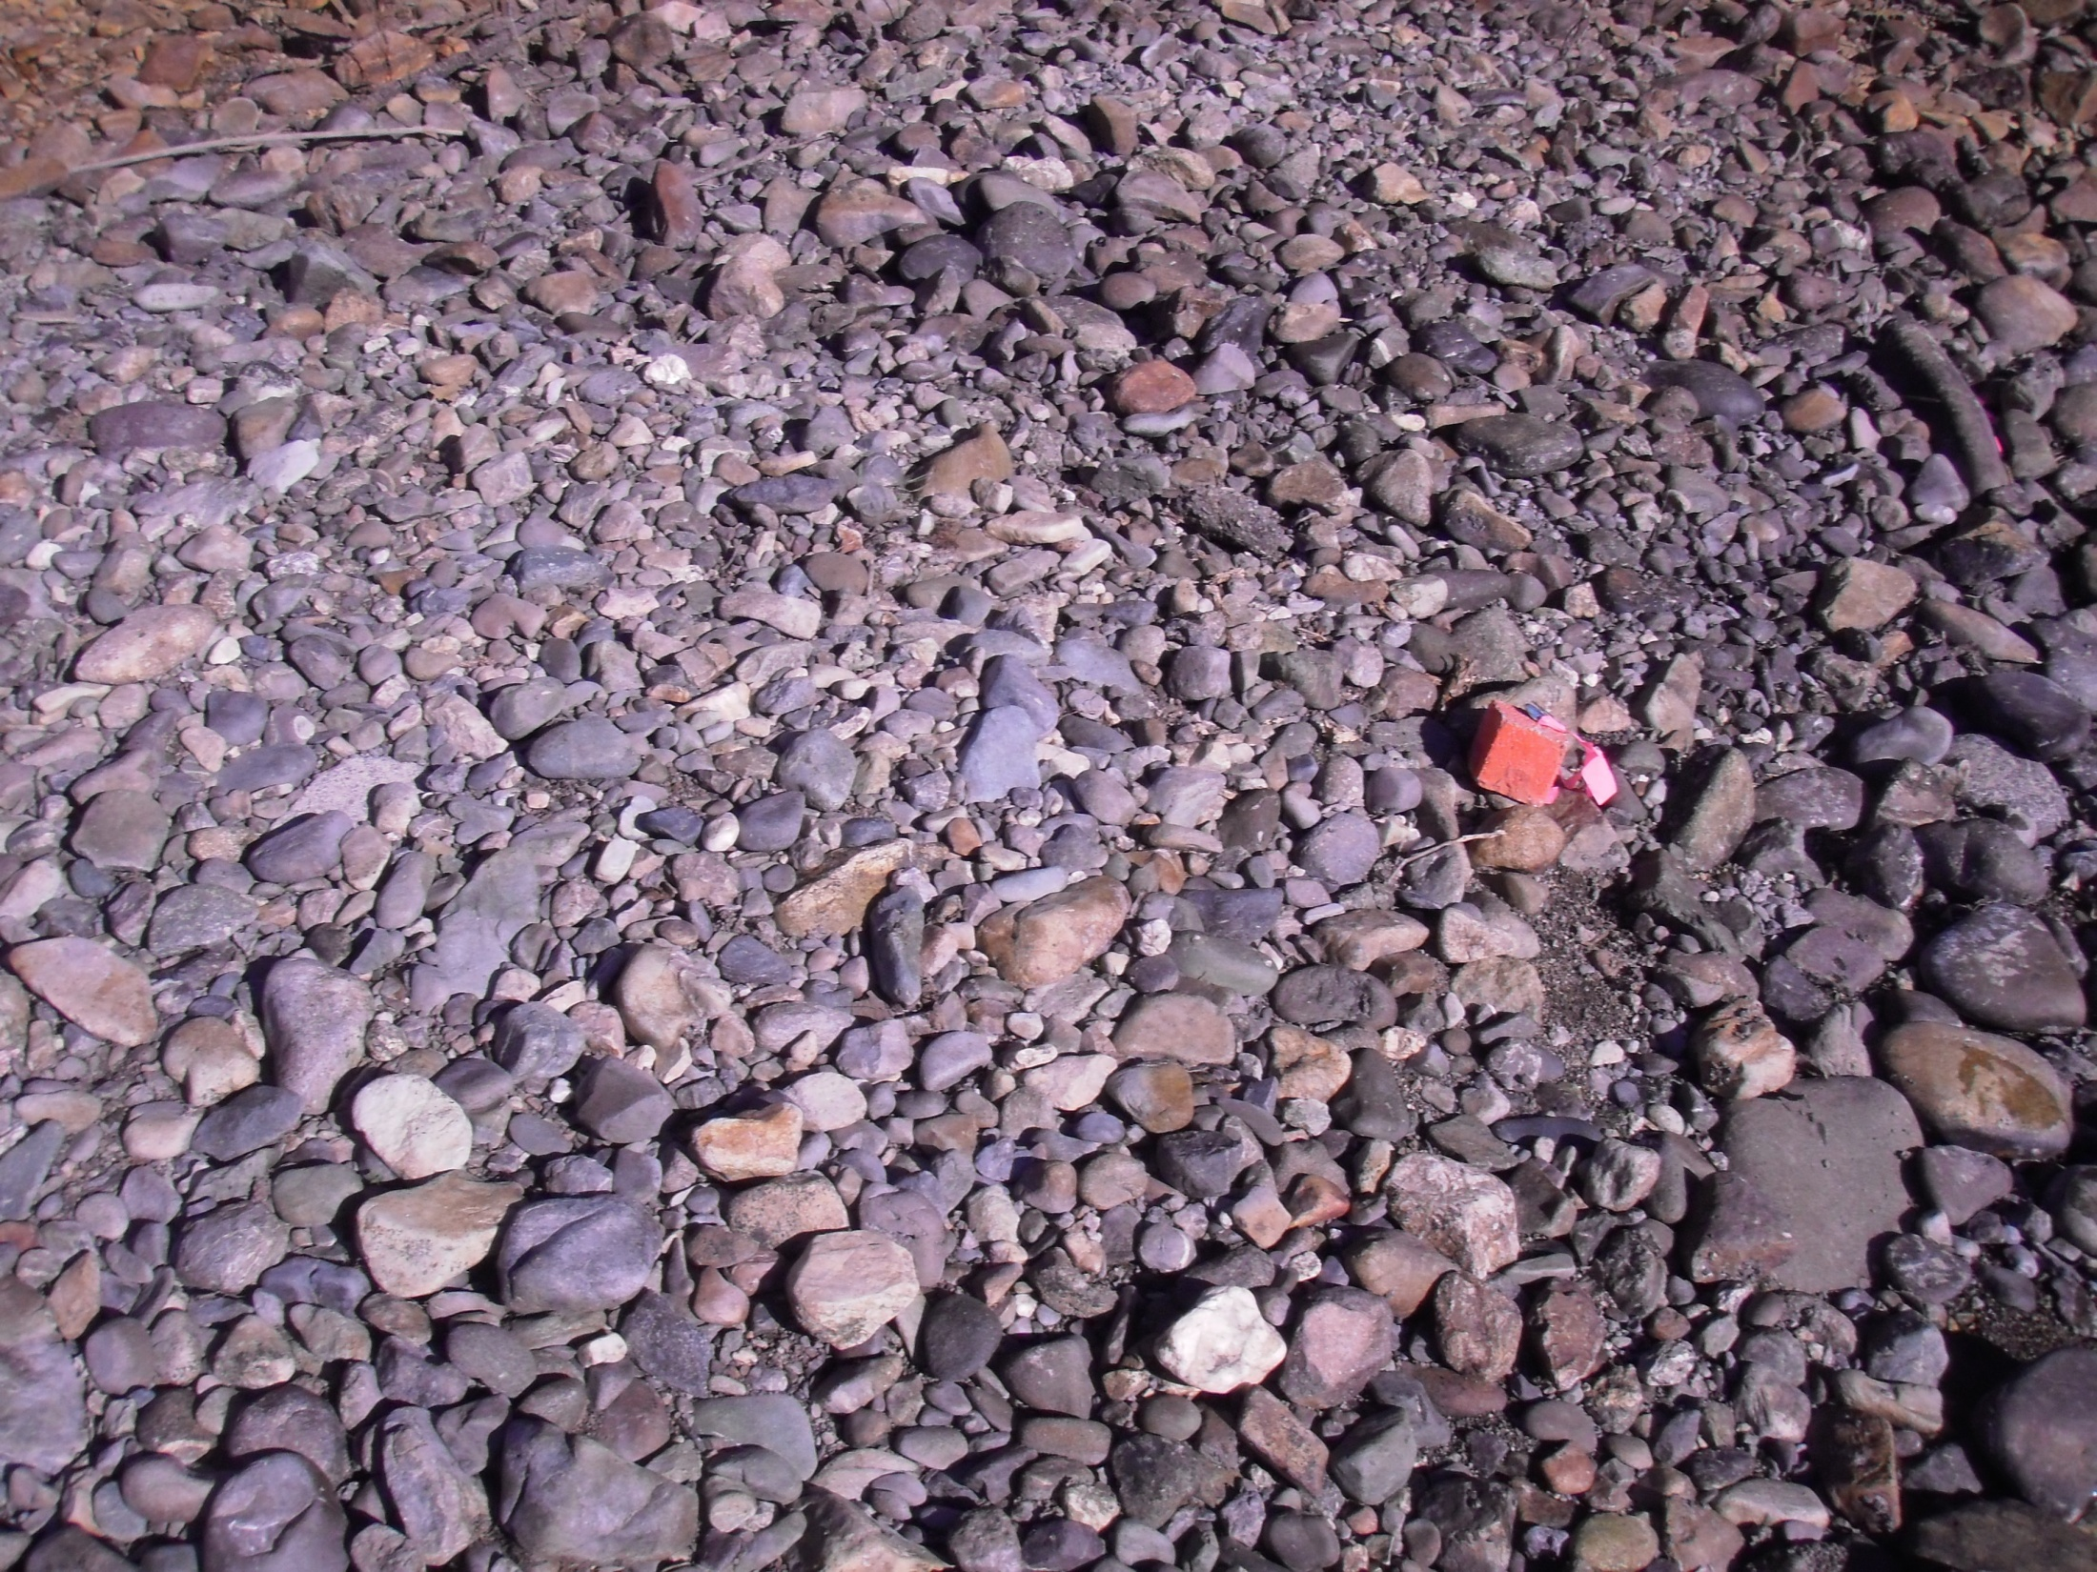
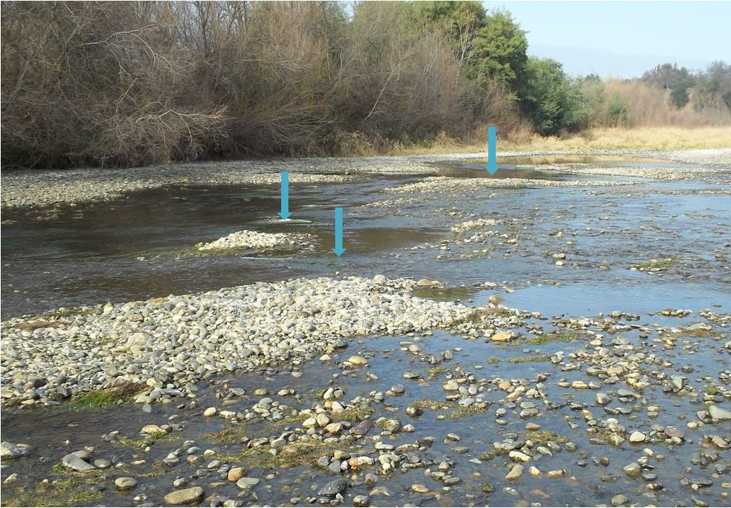

Slide 12
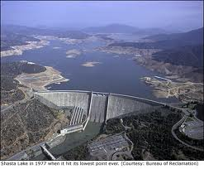
COMPETING DEMANDS ON SHASTA LAKE WATER
Water Supply Delivery/Storage
Winter-Run Cold Water Pool
Flood Management
Fall-Run Spawning

Slide 13
Keswick Reservoir Release
Fall 2011 – Winter 2012
9,000
7,500
CFS
6,000
3,372
4,500
3,000
30-Sep 30-Oct 30-Nov 30-Dec 30-Jan
Eggs and Fry in Gravel - 60 to 90 days

Slide 14
Keswick Reservoir Release
Fall 2009 – Winter 2010
9,000
7,500
CFS
6,000
3,250
4,500
3,000
30-Sep 30-Oct 30-Nov 30-Dec 30-Jan
Eggs and Fry in Gravel - 60 to 90 days

Slide 15
Keswick Reservoir Release
Fall 2006 – Winter 2007
9,000
7,500
CFS
6,000
4,500
3,000
30-Sep 30-Oct 30-Nov 30-Dec 30-Jan
Eggs and Fry in Gravel - 60 to 90 days

Slide 16
Monitoring and Assessment
Ground/Boat Based redd survey
Mark and record accurate location of redd
Record when redd was created
Fall-run Spawning
Oct
Nov
Dec
Jan
Feb
Mar

Slide 17
DURING LOW-FLOW PERIODS
Record dewatered redds and state of dewatering
Map dewatered spawning areas
Eggs and Fry in Gravel - 60 to 90 days
Oct
Nov
Dec
Jan
Feb
Mar

Slide 18
2011-2012 DFG Survey
Dewatered Redds
Fall-run Spawning
Eggs and Fry in Gravel - 60 to 90 days
Oct
Nov
Dec
Jan
Feb
Mar

Slide 19
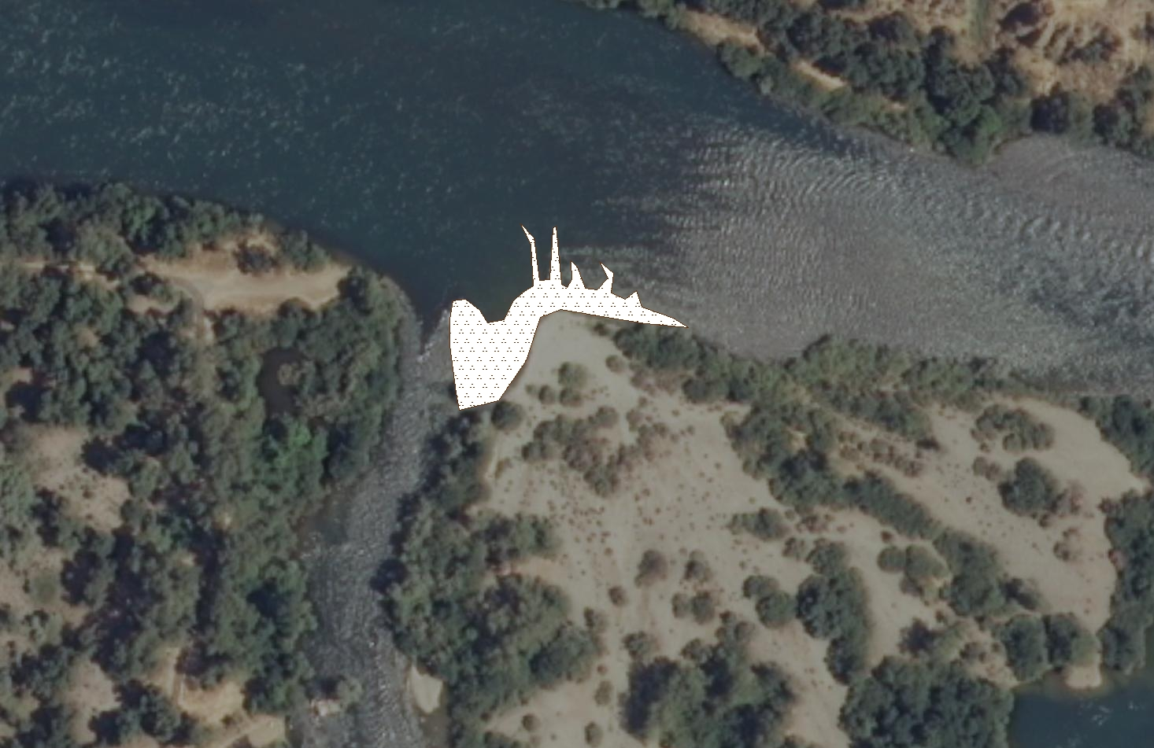
Area Subject to Dewatering
Mapped 2009/2010

Slide 20
Fall-run Redds Mapped 2011/2012
Area Subject to Dewatering
Mapped 2009/2010

Slide 21
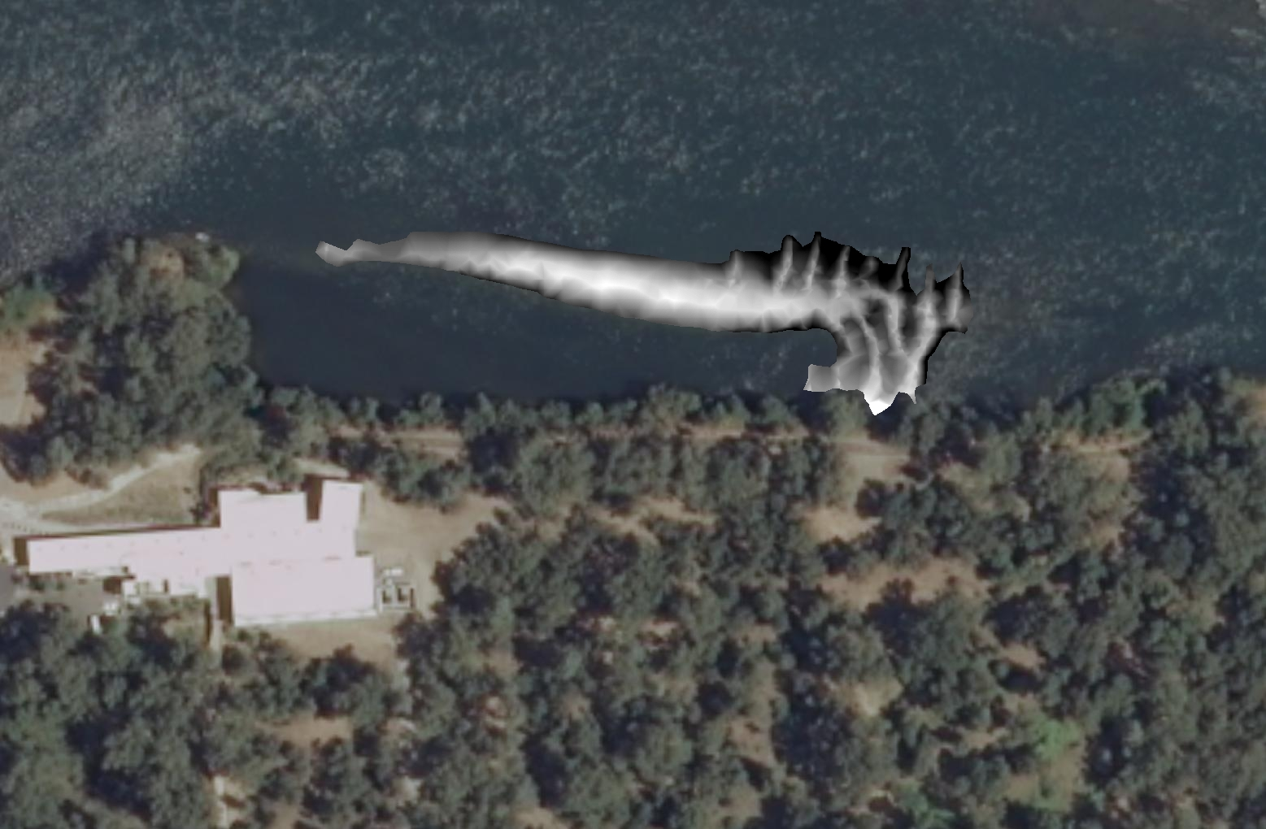
Topographic Survey to Determine Stage/Discharge Relationship

Slide 22
What’s next?

