Slide 1
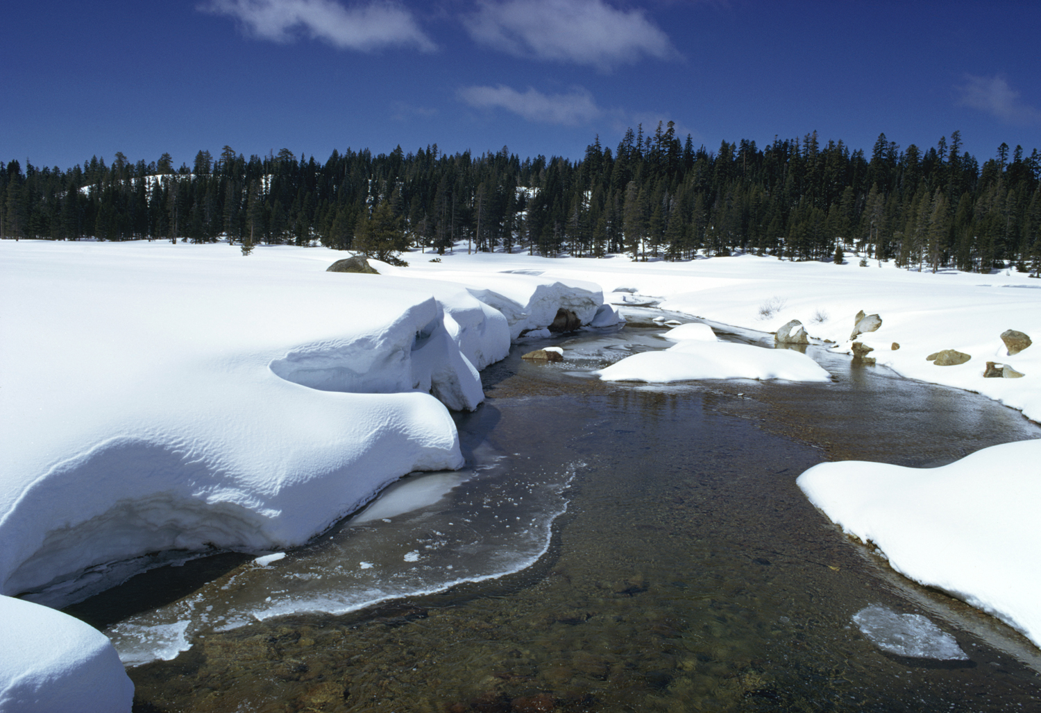

California Weather
Notes:
Intro myself,
PM II for CC program
CWP under Paul, section chief of the Climate Adaptation Section
Project not yet past the charter phase, so have to supply independent update from the Dashboards, but working towards this summer.

Slide 2
Climate vs. Weather
Climate:
Long term average conditions
Weather:
The conditions day to day
Notes:
Intro myself,
PM II for CC program
CWP under Paul, section chief of the Climate Adaptation Section
Project not yet past the charter phase, so have to supply independent update from the Dashboards, but working towards this summer.

Slide 3
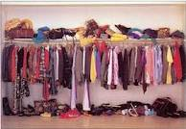
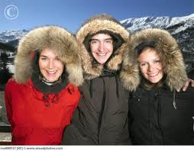
Climate vs. Weather
Climate:
Weather:
Notes:
Intro myself,
PM II for CC program
CWP under Paul, section chief of the Climate Adaptation Section
Project not yet past the charter phase, so have to supply independent update from the Dashboards, but working towards this summer.

Slide 4
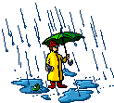
Water Year

Slide 5
Water Year
Hydrologic Water Year
California:
October 1 – September 30

Slide 6
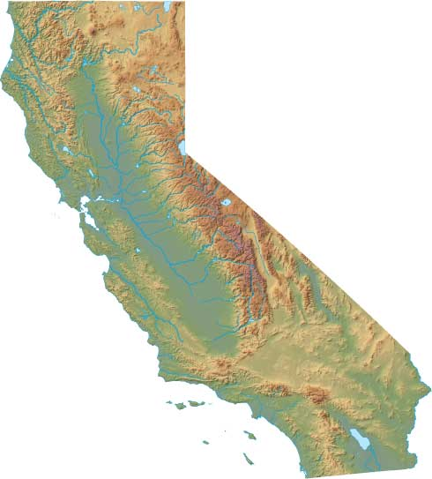
Precipitation
Northern Sierra 8 Station Index
Mt. Shasta City
Shasta Dam
Mineral
Brush Creek
Quincy
Sierraville
Pacific House
Blue Canyon
Notes:
Representative data collection for Shasta, Oroville, Folsom reservoir inflow areas

Slide 7
Precipitation
San Joaquin 5-Station Index
Calaveras Big Trees
Hetch Hetchy
Yosemite Headquarters
North Fork
Huntington
Notes:
Representative data collection for Shasta, Oroville, Folsom reservoir inflow areas

Slide 8
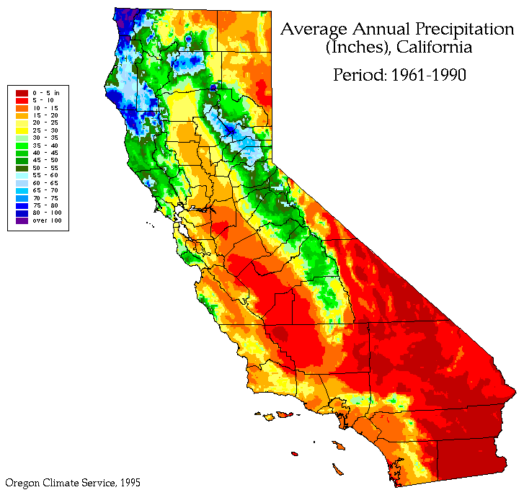
PRISM (Parameter-elevation Regressions on Independent Slopes Model)

Slide 9

Same
Solar
Energy
More Heating
Less Heating
S
U
N
Winter
Summer

Slide 10
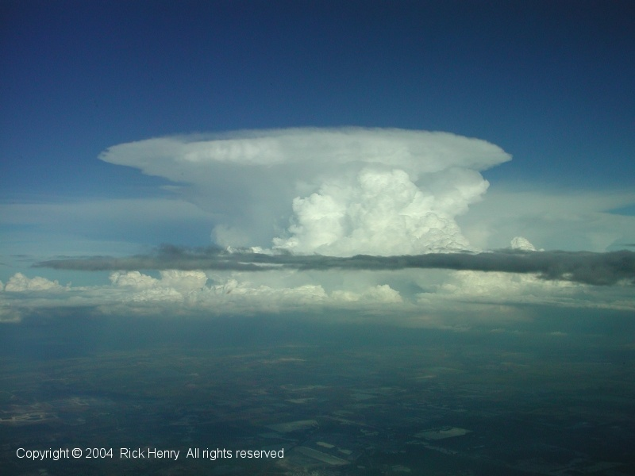
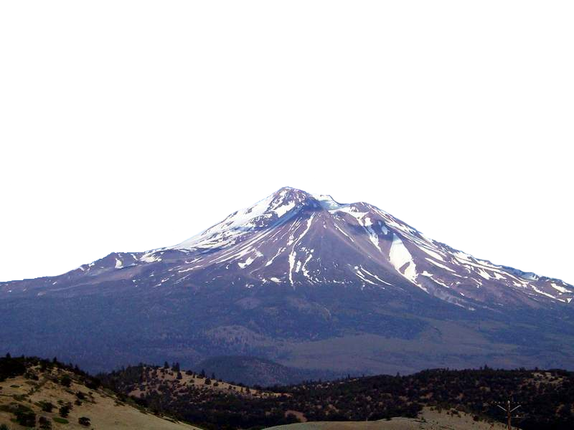

Temperature:
-60
-50
-40
-30
-20
-10
0
+10
+20
Pressure:
39,000 Feet
200 MB
18,000 Feet
500 MB
10,000 Feet
700 MB
5,000 Feet
850 MB
Sea Level
1013 MB
Degrees Centigrade
-60
-50
-40
-30
-20
-10
0
+10
+20
Troposphere; lowest layer
Notes:
1013 MB is equal to 14.5 PSI
Troposhere, Tropopause, Stratosphere

Slide 11
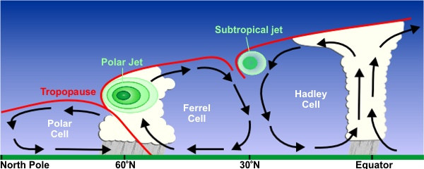
Jet Stream
Notes:
George Hadley, Willi
Jet streams are fast flowing, narrow air currents found in the atmospheres of some planets, including Earth. The main jet streams are located near the tropopause, the transition between the troposphere (where temperature decreases with altitude) and the stratosphere (where temperature increases with altitude).^{[1]} The major jet streams on Earth are westerly winds (flowing west to east). Their paths typically have a meandering shape; jet streams may start, stop, split into two or more parts, combine into one stream, or flow in various directions including the opposite direction of most of the jet. The strongest jet streams are the polar jets, at around 7–12 km (23,000–39,000 ft) above sea level, and the higher and somewhat weaker subtropical jets at around 10–16 km (33,000–52,000 ft). The northern hemisphere and the southern hemisphere each have both a polar jet and a subtropical jet. The northern hemisphere polar jet flows over the middle to northern latitudes of North America, Europe, and Asia and their intervening oceans, while the southern hemisphere polar jet mostly circles Antarctica all year round.
Jet streams are caused by a combination of a planet's rotation on its axis and atmospheric heating (by solar radiation and, on some planets other than Earth, internal heat). Jet streams form near boundaries of adjacent air masses with significant differences in temperature, such as the polar region and the warmer air towards the equator.^{[2]}
am Ferrel. Ferrel Cell acts as an atmospheric ball bearing.

Slide 12
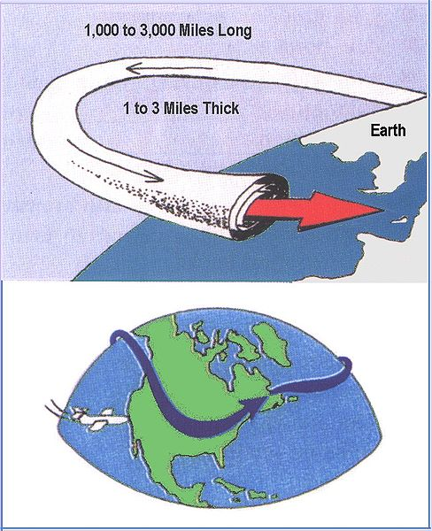
Jet Stream
Notes:
George Hadley, William ferrel. Speeds from 25-250 mph.
Jet streams are fast flowing, narrow air currents found in the atmospheres of some planets, including Earth. The main jet streams are located near the tropopause, the transition between the troposphere (where temperature decreases with altitude) and the stratosphere (where temperature increases with altitude).^{[1]} The major jet streams on Earth are westerly winds (flowing west to east). Their paths typically have a meandering shape; jet streams may start, stop, split into two or more parts, combine into one stream, or flow in various directions including the opposite direction of most of the jet. The strongest jet streams are the polar jets, at around 7–12 km (23,000–39,000 ft) above sea level, and the higher and somewhat weaker subtropical jets at around 10–16 km (33,000–52,000 ft). The northern hemisphere and the southern hemisphere each have both a polar jet and a subtropical jet. The northern hemisphere polar jet flows over the middle to northern latitudes of North America, Europe, and Asia and their intervening oceans, while the southern hemisphere polar jet mostly circles Antarctica all year round.
Jet streams are caused by a combination of a planet's rotation on its axis and atmospheric heating (by solar radiation and, on some planets other than Earth, internal heat). Jet streams form near boundaries of adjacent air masses with significant differences in temperature, such as the polar region and the warmer air towards the equator.^{[2]}
am Ferrel. Ferrel Cell acts as an atmospheric ball bearing.

Slide 13
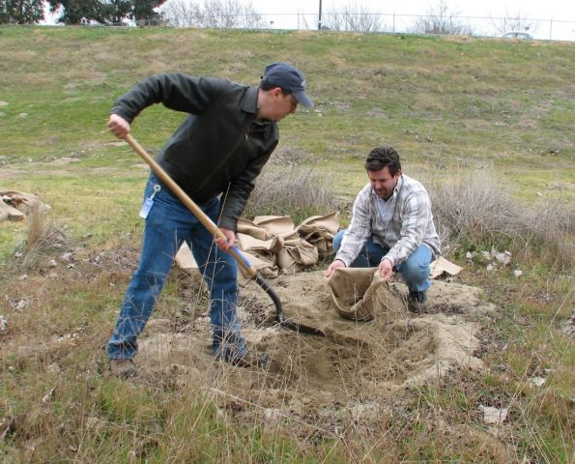
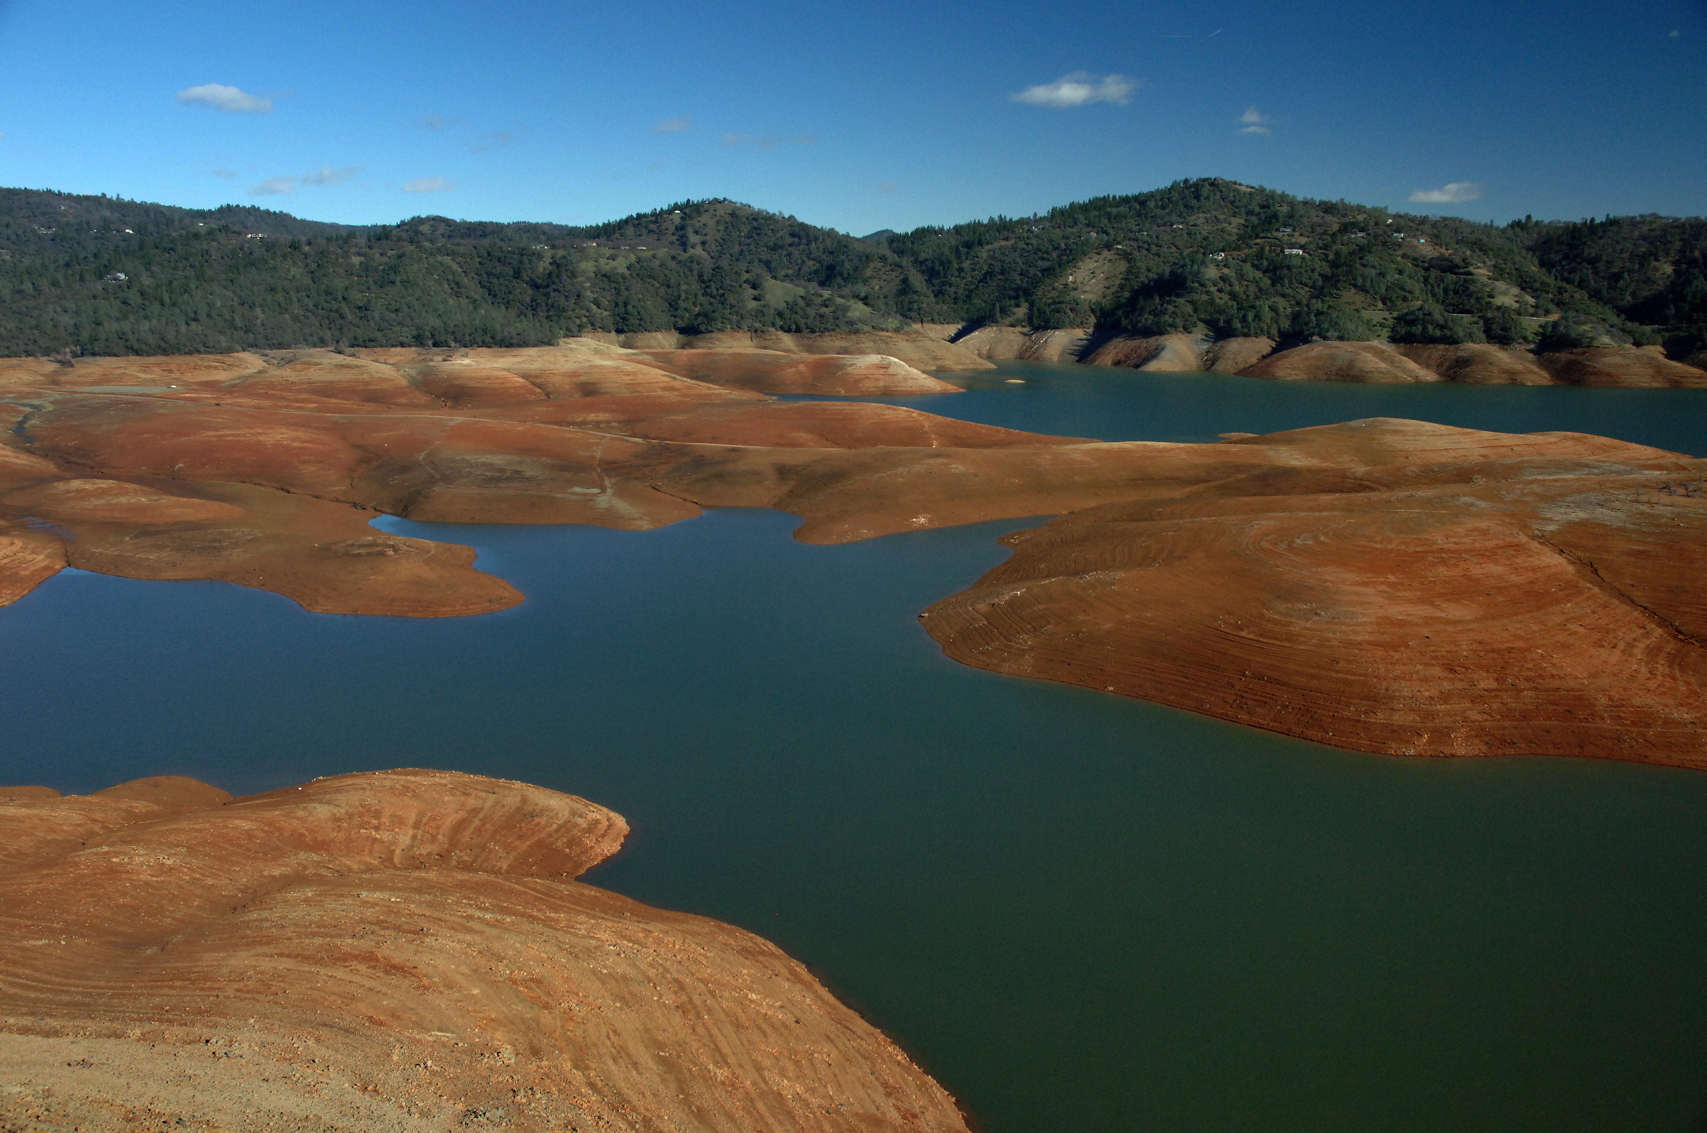
Winter vs. Summer in California

Slide 14
Winter Jet toward CA
Winter: Jet points toward CA
COLD From NW, Alaska

Slide 15
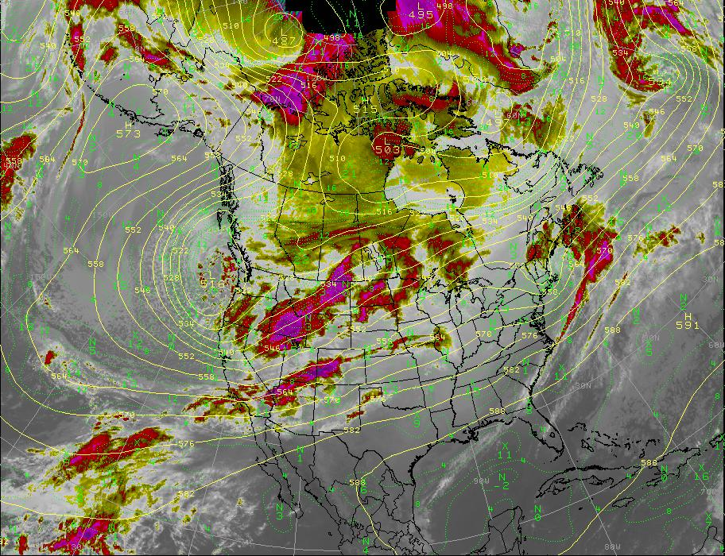
Winter Jet toward CA
Winter: Jet points toward CA
COLD From NW, Alaska

Slide 16
Winter Jet toward CA
Winter: Jet points toward CA
COLD From NW, Alaska

Slide 17
Winter Jet toward CA
WARM: From West or SW
“Pineapple Express” (Atmospheric Rivers)

Slide 18
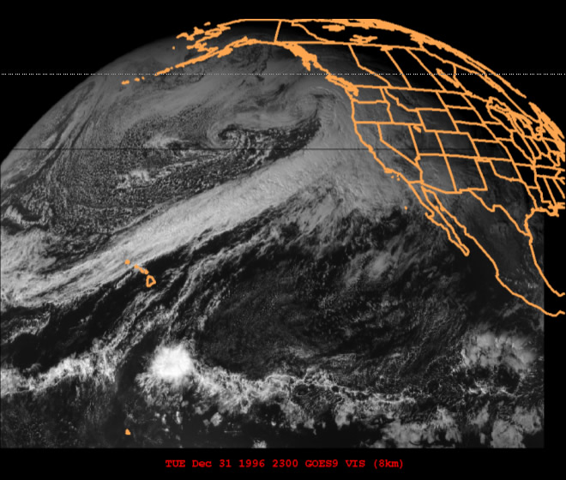
Winter Jet toward CA
WARM: From West or SW
“Pineapple Express” (Atmospheric Rivers)

Slide 19
Summer Jet Stream
DRY Summers: Jet points toward
Washington, Canada

Slide 20
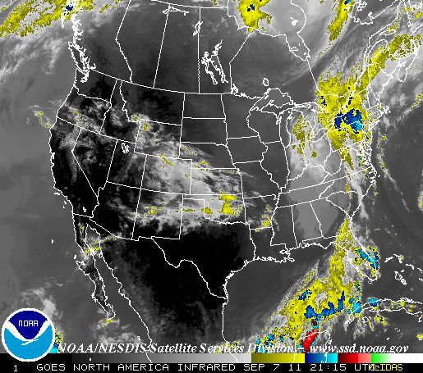
Summer Jet Stream
DRY Summers: Jet points toward
Washington, Canada

Slide 21
Summer Jet Stream
DRY Summers: Jet points toward
Washington, Canada

Slide 22
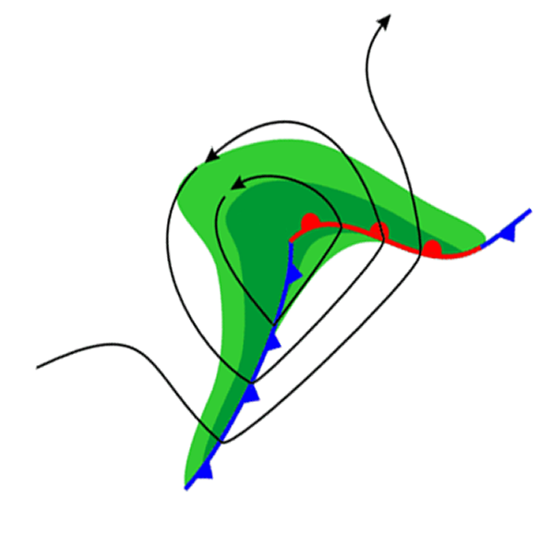
Front
Boundary between 2
air masses
L
COLD
WARM

Slide 23
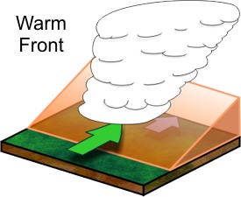
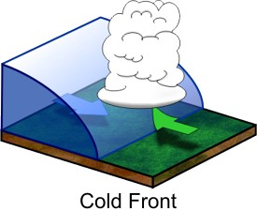
Front
Boundary between 2
air masses
L
COLD
WARM
Notes:
Warm front stratus clouds, Cold front's location is at the leading edge of the temperature drop off, Cumulonimbus clouds.

Slide 24
Wind
Air in motion
caused High a Low Pressure

Slide 25
Wind
Air in motion
caused High a Low Pressure
Speed
measured with an anemometer

Slide 26
Wind
Air in motion
caused High a Low Pressure
Speed
measured with an anemometer
Direction
described from which it is blowing

Slide 27
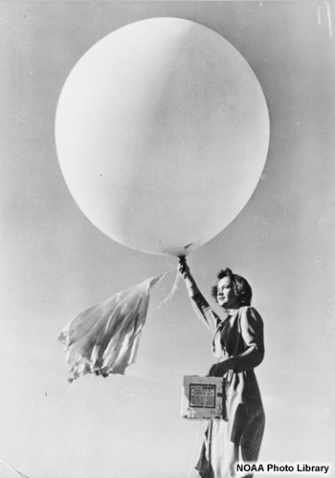
Radiosonde ; Weather Balloon
Temperature
Humidity
Pressure
Wind Speed
Wind Direction
National Weather Service Launches twice daily
12 UTC (4 AM PST) and 00 UTC (4 PM PST)

Slide 28
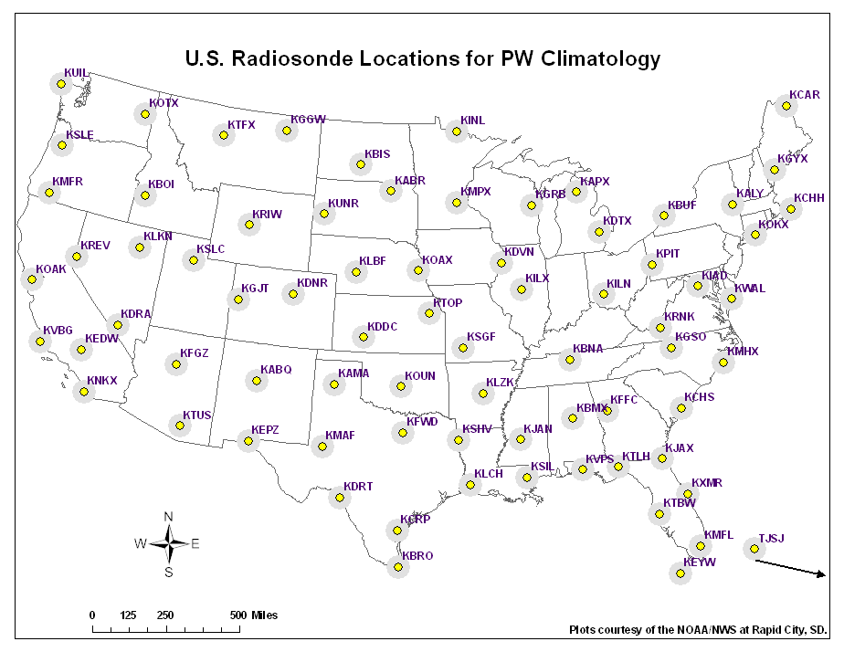

Slide 29
L
H
L
H
Weather Map

Slide 30
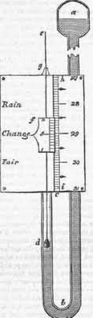
Demonstration-
Explaining
AIR PRESSURE!

Slide 31
Surface Low Pressure
Cloudy
Rainy or
Worsening
L
cyclonic
(counter-
clockwise)
convergence

Slide 32
Surface High Pressure
Improving
or clearing
skies
H
anticyclonic
(clockwise)
divergence

Slide 33
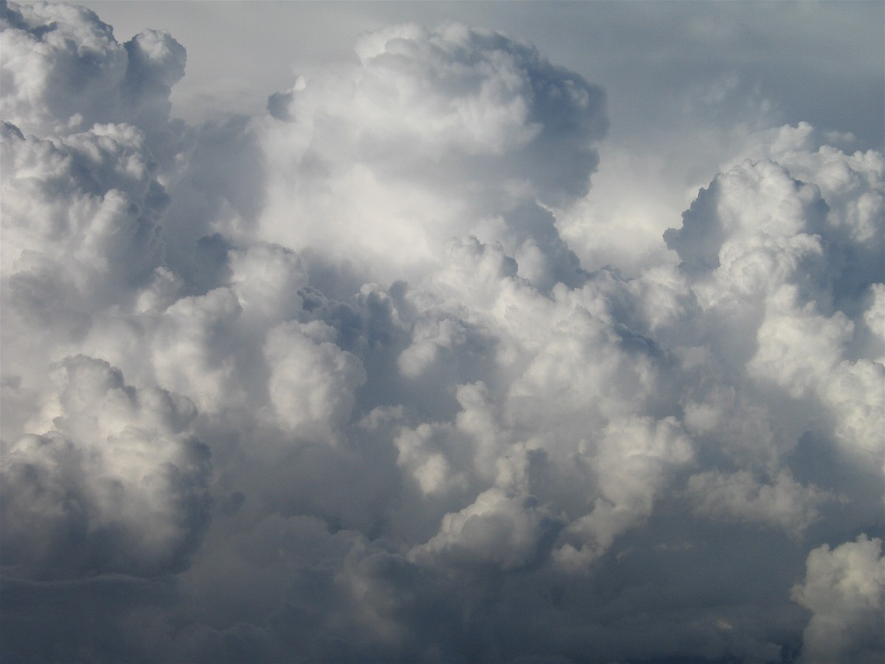
Moisture + Lift = Precipitation

Slide 34
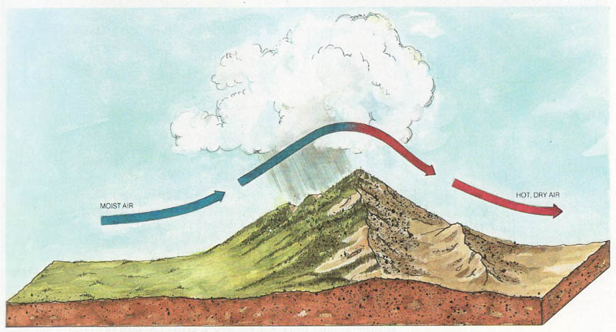
Orographic Precipitation

Slide 35
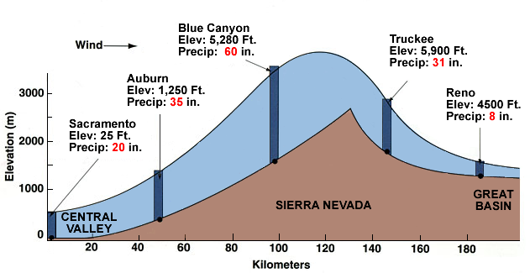
Orographic Precipitation

Slide 36
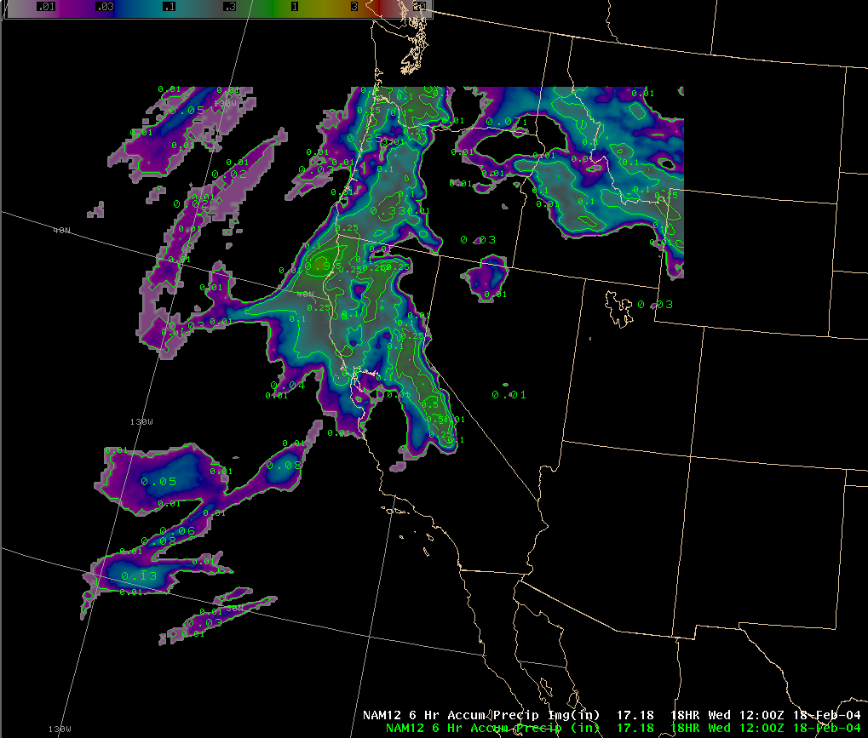
Numerical Weather Prediction

Slide 37
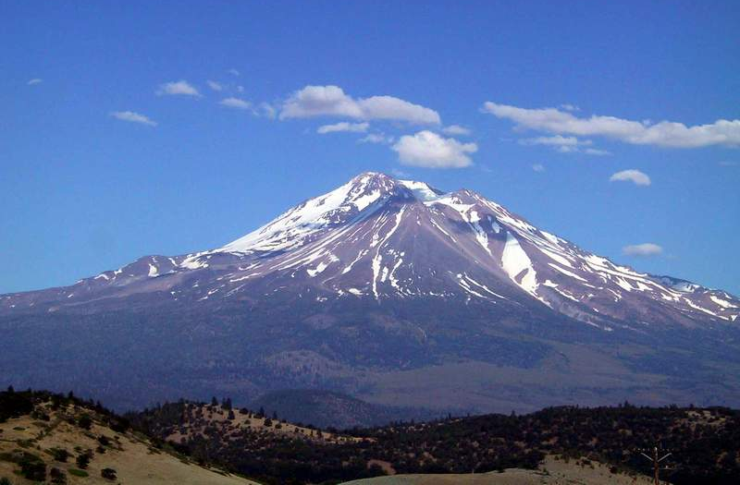
Summary
Varying amounts of Sunlight create the jet stream and weather
A few storms per year determine most of State’s water supply

