Slide 1
Restoration Land Ownership History along the Sacramento River
1995 to 2011

Slide 2
How many acres of privately held land have come under conservation ownership?
Where have these changes taken place?
Prior owner / land use
Analysis period
CALFED Ecosystem-Restoration Program funding years 1995-2005
Notes:
ERP proposals – ended in 2005, but a few projects are still underway

Slide 3
Phelan Island in 1947
Notes:
Phelan Island - SacRiver National Wildlife Refuge (1947) near RM 192

Slide 4
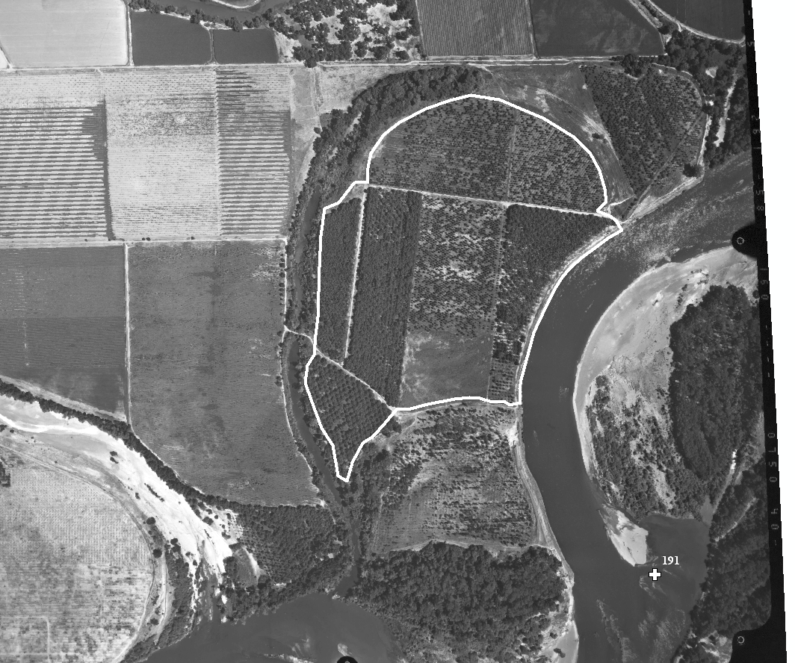
11995
Notes:
Phelan Island

Slide 5
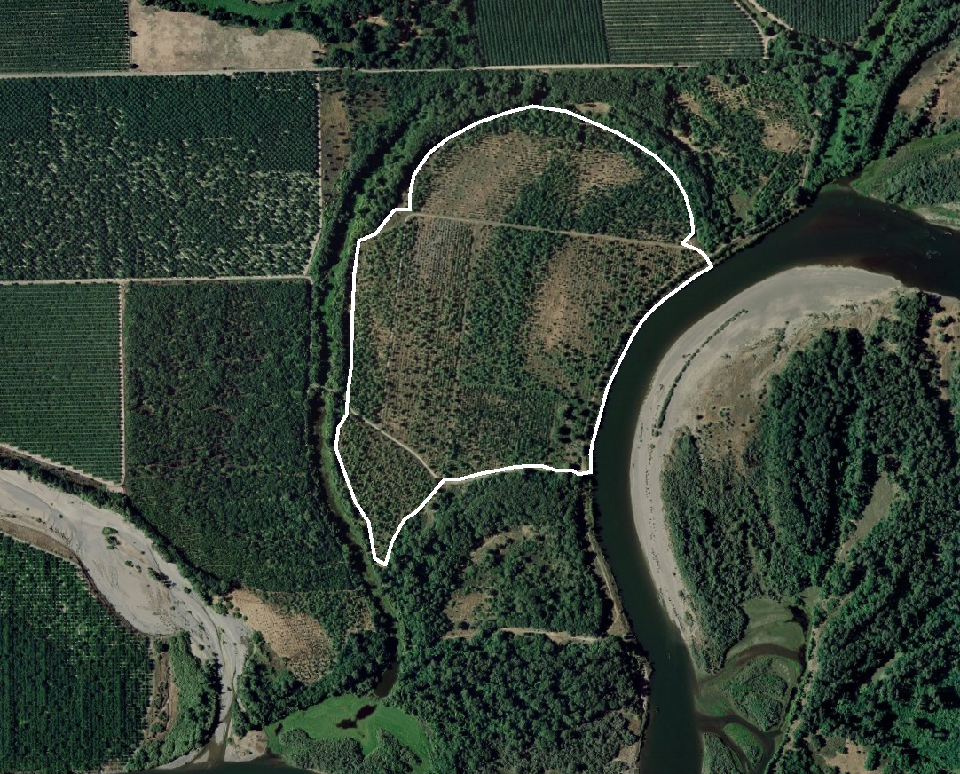
2007
Notes:
TNC Restoration – Mixed Riparian in 1999

Slide 6
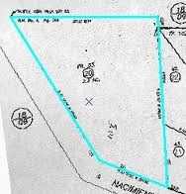
Step 1: Inventory Conservation Properties
Map all properties in conservation within the Sacramento River Conservation Area

Slide 7
Conservation Ownership Information Sources:
County Assessors
Dept. of Fish and Game
USFWS
The Nature Conservancy
The California Protected Areas database
CA Dept. of Water Resources public lands data
Wildlife Conservation Board projects database
CSU Chico Geographic Information Center public access data
US government ownership database
California Habitat Restoration Project Database (CHRPD)
SRCAF Project Tracker
Notes:
TNC: Seth Paine provided a database of TNC properties with years acquired and management activities
Robin Carlson - (CALFED ERP project database)
The CHRPD is a cooperative project funded by NOAA Fisheries and the California Department of Fish and Game and managed by the Pacific States Marine Fisheries Commission.

Slide 8
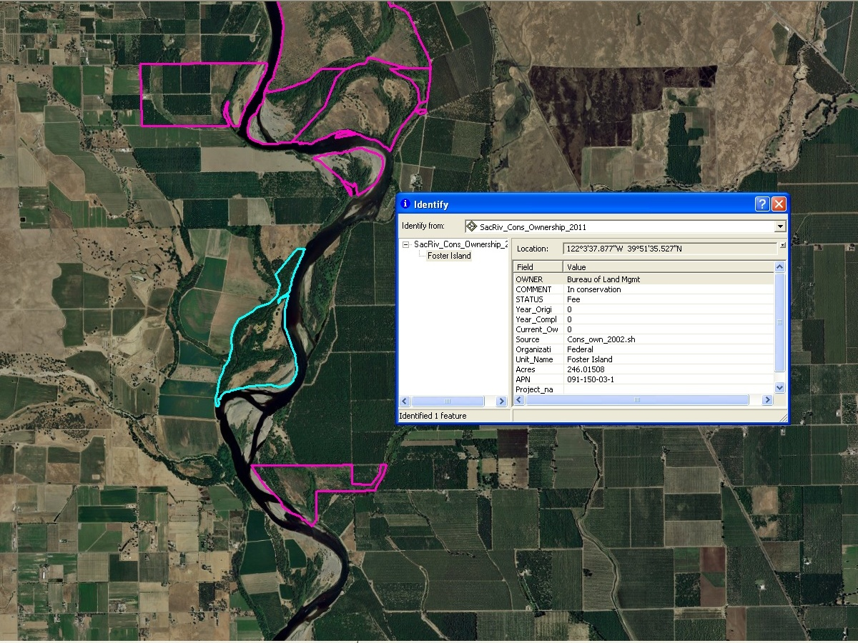

Slide 9
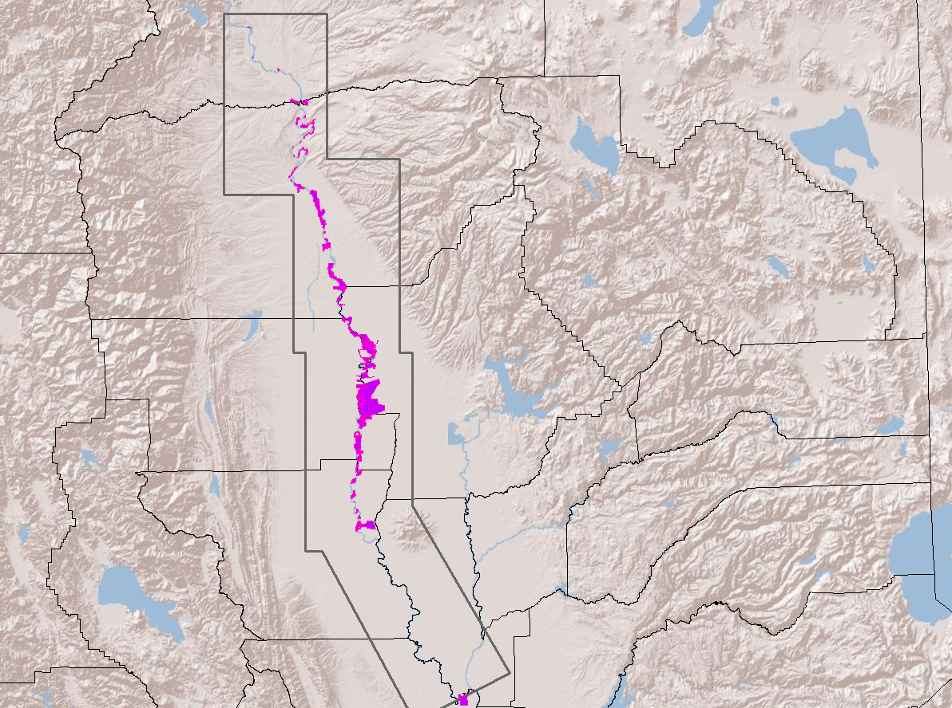
Notes:
182 properties mapped to date

Slide 10
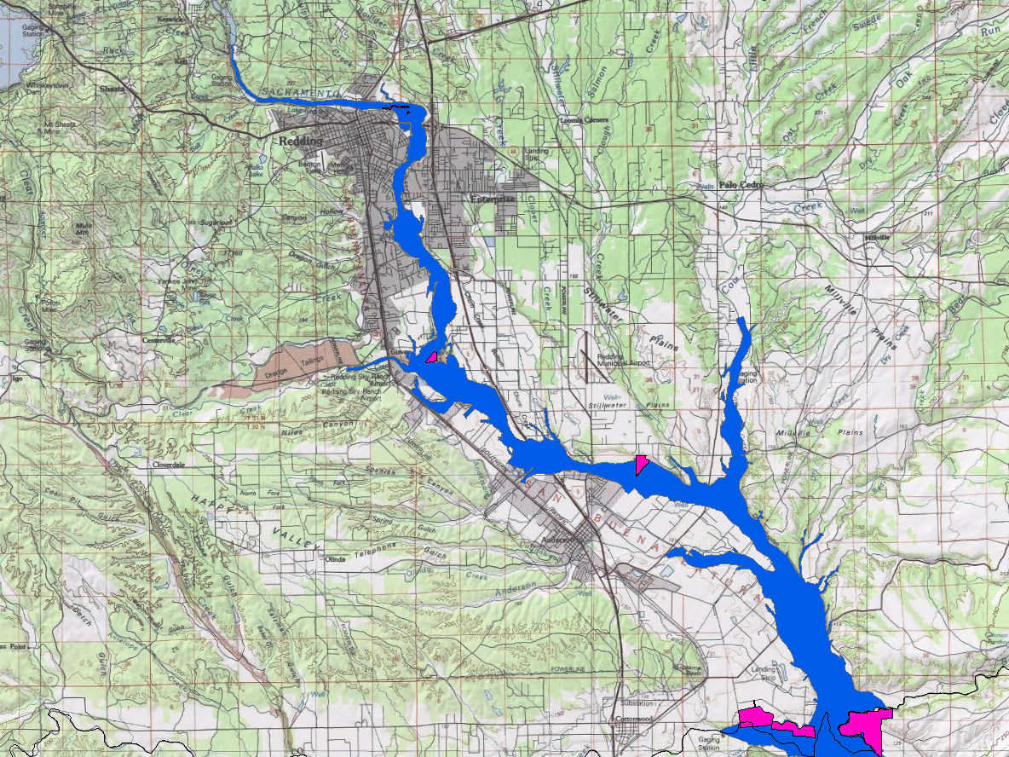
Notes:
Reach 1 – Shasta to Tehama

Slide 11
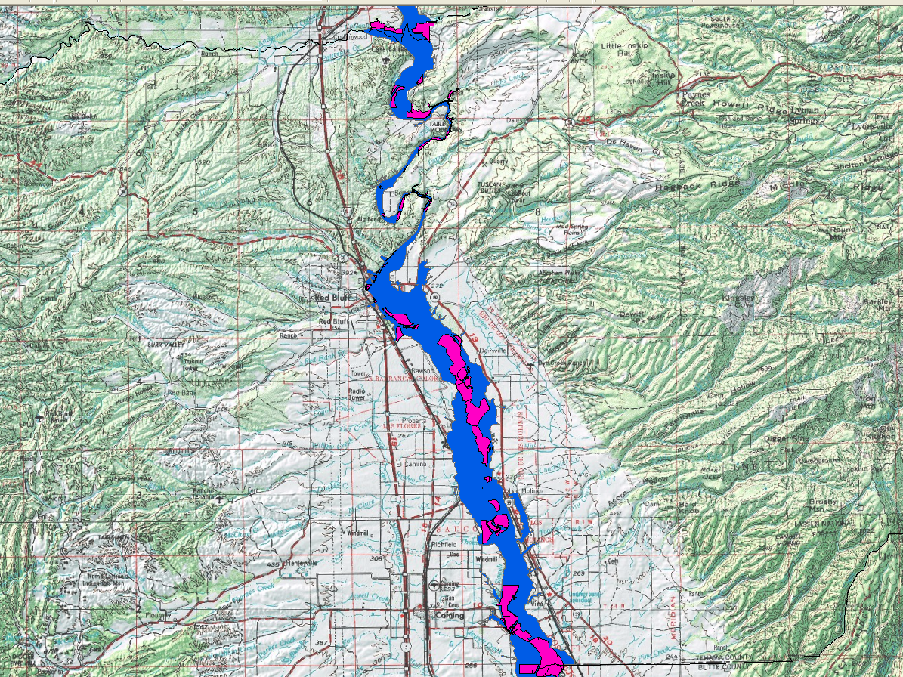

Slide 12
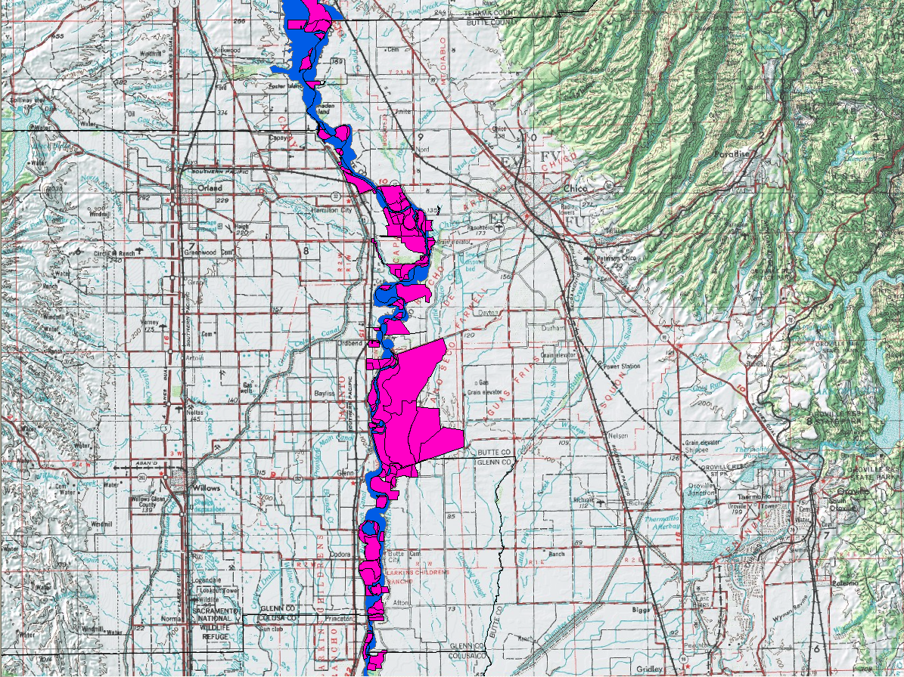
Notes:
Reach 2 – Tehama -> Butte/Glenn → Colusa

Slide 13
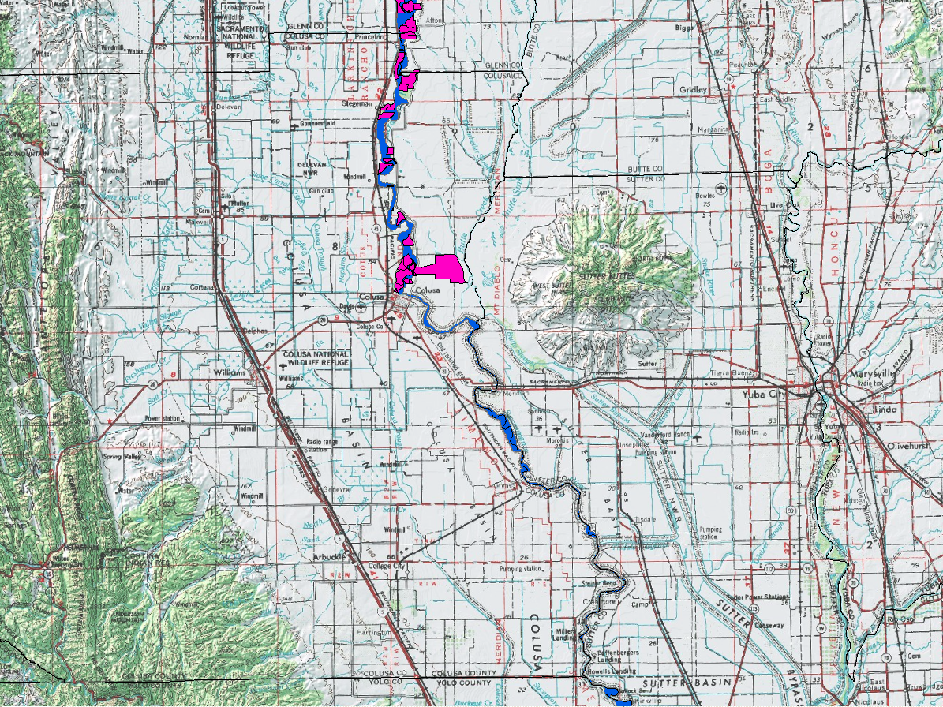
Notes:
Reach 3+4 Colusa/Sutter
Colusa Weir

Slide 14
Step 2: Determine Year of Ownership Change
Recorded documents
Interview current owner
Other documents (Management plans, restoration plans, existing databases, etc.)
Notes:
Current Step:
Contacted:
Dale Stroud (Tehama County Assessor) – is preparing a spreadsheet of title changes to public/conservation
Chip Merriam (Glenn County Assessor) – APN cross-reference with Recorders records

Slide 15
Next Steps:
Finalize property boundaries & years
Report & Maps

