Slide 1
Irrigated Lands Program Update – Sacramento River Conservation Forum
Bruce Houdesheldt Director Regulatory Affairs
Northern California Water Association

Slide 3
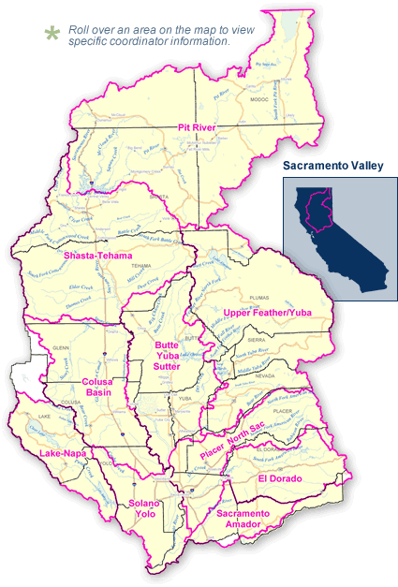

Slide 5
Elements of the Irrigated Lands Program
Monitoring and Reporting Program Plan
Annual Monitoring Report – 2009 and 2010
Management Plan
Management Plan Progress Report
TMDLs
Future Irrigated Lands Regulatory Program

Slide 6
Monitoring and Reporting Program Plan
Monitoring begun in 2002 at sites representative of irrigated agriculture
In 2009 Regional Board established Monitoring Cycle – Assessment, Core, Core
Butte Yuba Sutter Subwatershed Monitoring Sites –
Lower Honcut Creek @ Hwy 70 (12)
Lower Snake River @ Nuestro Road (12)
Pine Creek @ Nord Gianella Road (12)
Sacramento Slough Bridge near Karnak (12)
Butte Slough @ Pass Road (6)
Gilsizer Slough @ GW Road (3)
Wadsworth Canal @ S Butte Road

Slide 7
Results to Date
From 2005 -2010 (Exceedances/Samples)
Drinking Water
Nitrate (0/128)
TDS (1/103
Agriculture
Boron (0/30)
Conductivity (9/194)
Recreation
E. coli (45/153)

Slide 8
Results to Date
From 2005 -2010 (Exceedances/Samples)
Aquatic Life
Toxicity – Invertebrates (5/70)
Toxicity – Fish (0/51)
Toxicity – Algae (3/56)
Toxicity – Sediment (2/15)
Chlorpyrifos (5/114)
Diaznon (5/114)
Diuron (0/80)
Malathion (2/114)
Parathion, Methyl (1/114)
Simazine (0/62)
Copper, Dissolved (0/65)
pH (5/182)
Dissolved Oxygen (15/194)

Slide 9
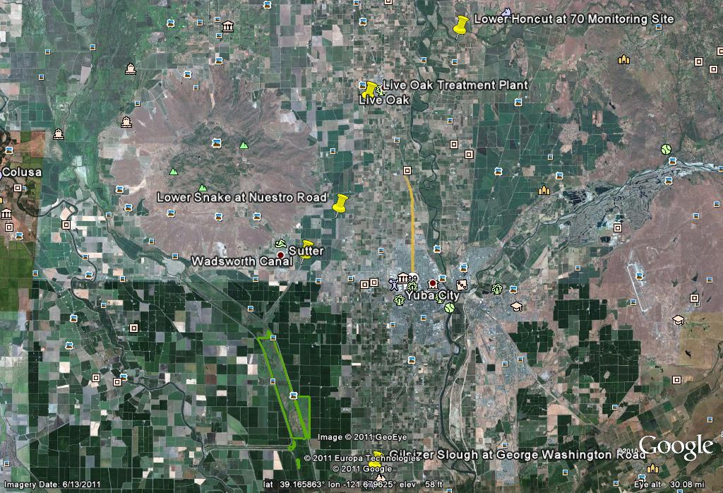

Slide 10
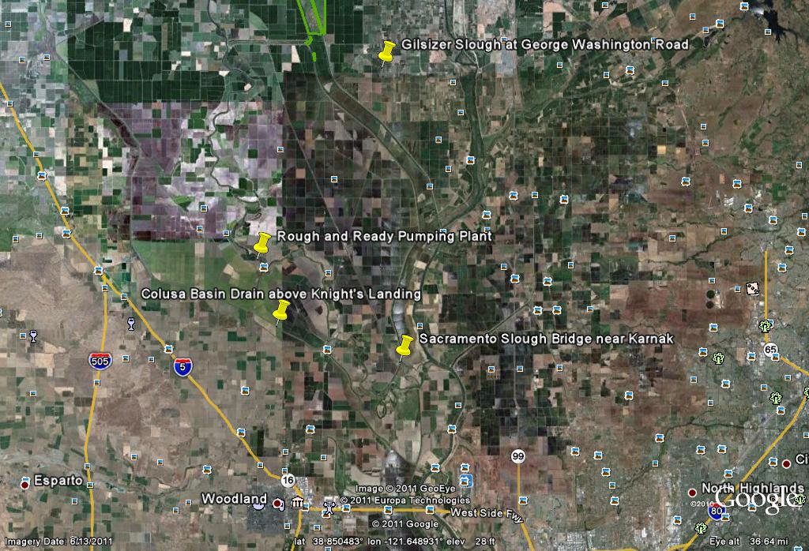

Slide 11
Management Plans
Gilsizer Slough – Diazinon, Salinity, Legacy Pesticides, E. coli
Lower Snake River – E. coli
Pine Creek – E. coli, Chlorpyrifos
Wadsworth Canal – E. coli
Lower Honcut – E. coli

Slide 12
Management Plan Implementation Cycle

Slide 13
Butte-Yuba-Sutter Water Quality Coalition
Presented by:
Sutter County Resource Conservation District (SCRCD)
Larry Lloyd – District Manager

Slide 14
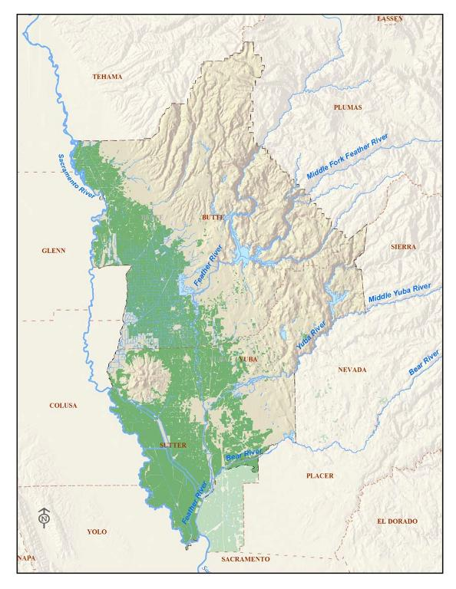
Butte-Yuba-Sutter Water Quality Coalition
BYSWQC Boundaries
.

Slide 15
Butte-Yuba-Sutter Water Quality Coalition
BYSWQC
A Three-County Coalition of irrigated agricultural producers
Approximately 1,200 members
Approximately 229,000 acres of irrigated agriculture
215,629 tons of peaches
92,481 tons of dried plums
151,071 tons of walnuts
38,517 tons of almonds in 2010.

Slide 16
Butte-Yuba-Sutter Water Quality Coalition
Outreach and Education Coordinators
SCRCD provides Outreach and Education Coordinators
Central Valley Regional Water Quality Control Board (Regional Board)
Inform members on changing water quality regulations
Assist members in efforts to comply with the ILRP

Slide 17
Butte-Yuba-Sutter Water Quality Coalition
Success Story

Slide 18
Butte-Yuba-Sutter Water Quality Coalition
US Environmental Protection Agency
Nonpoint Source Success Stories
“Stakeholders Cooperate to Reduce Diazinon in Runoff from Dormant Season Spray”
1994: Lower Feather River listed on 303(d) list for Diazinon impairment
2003: Total Maximum Daily Load (TMDL) established
2010: EPA delists LFR for Diazinon impairment

Slide 19
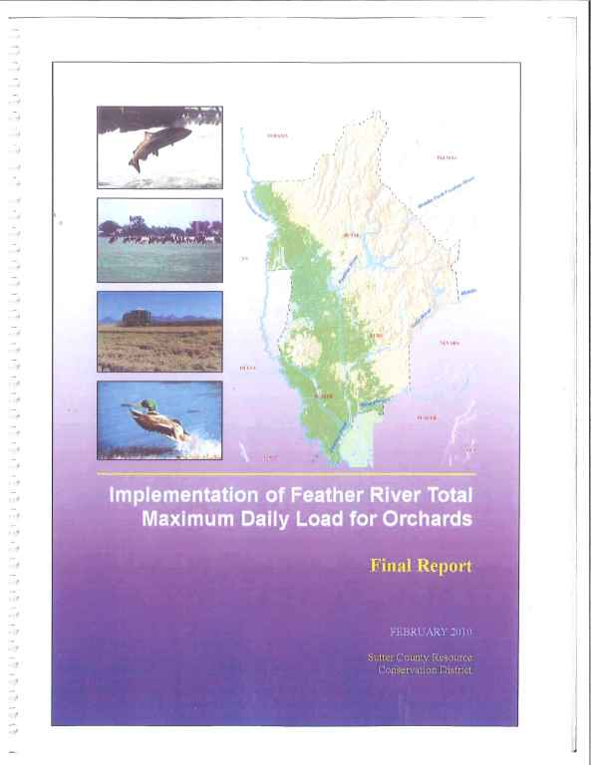
Butte-Yuba-Sutter Water Quality Coalition
Lower Feather River TMDL

Slide 20
Butte-Yuba-Sutter Water Quality Coalition
Lower Feather River TMDL
"Implementation of the Feather River TMDL for Orchards."
Best Management Practices
Reduce Diazinon in Runoff from Dormant Season Spray

Slide 21
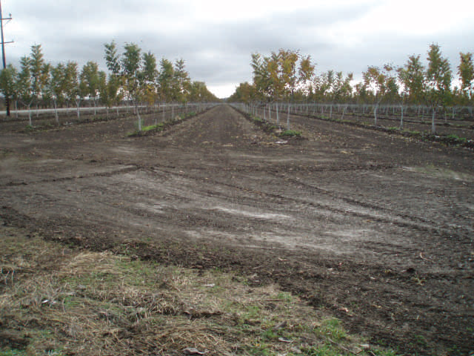
Butte-Yuba-Sutter Water Quality Coalition
Bare Orchard Floor in September

Slide 22
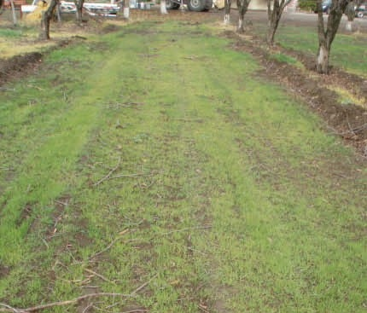
Butte-Yuba-Sutter Water Quality Coalition
SUCCESS STORY
Perennial Sod Emerging in Late December

Slide 23
Butte-Yuba-Sutter Water Quality Coalition
Outreach Coordinators
Larry Lloyd, Sutter County Resource Conservation District
Jim Cornelius, Sutter County Resource Conservation District
Administrators
Megan Foster, Yuba/Sutter Farm Bureau
Jaime Robertson, Yuba/Sutter Farm Bureau

Slide 24
Future Irrigated Lands Program
Groundwater quality
Tiering based on threat to surface and ground water quality
Groundwater Quality Monitoring Advisory Workgroup
ILRP Stakeholder Meeting
Sacramento Valley Water Quality Coalition Order – Summer or Fall 2012

Slide 25
Questions ?

